Slide 1
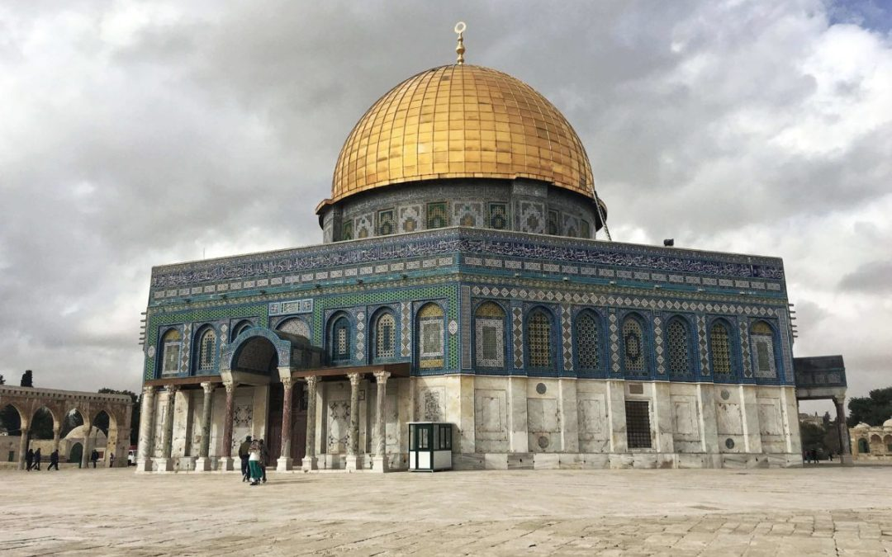
PRAISE THE LORD

Slide 2
Why is Bible unique?

Slide 3
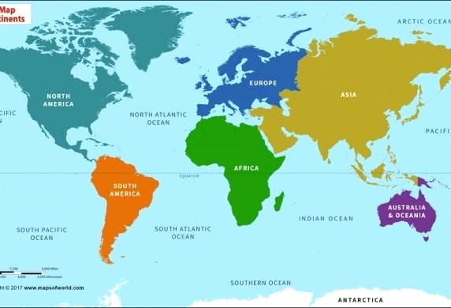
World Map

Slide 4
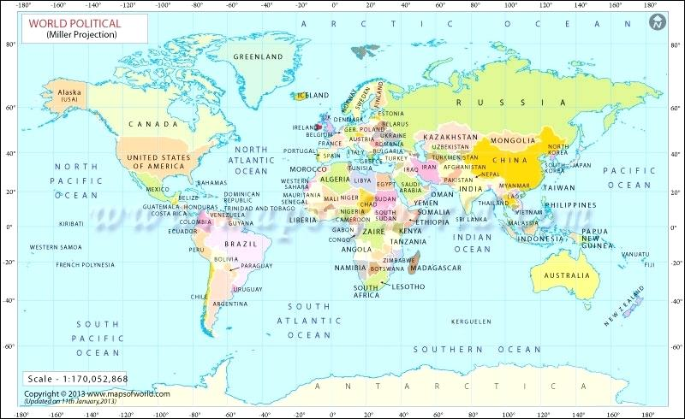

Slide 5
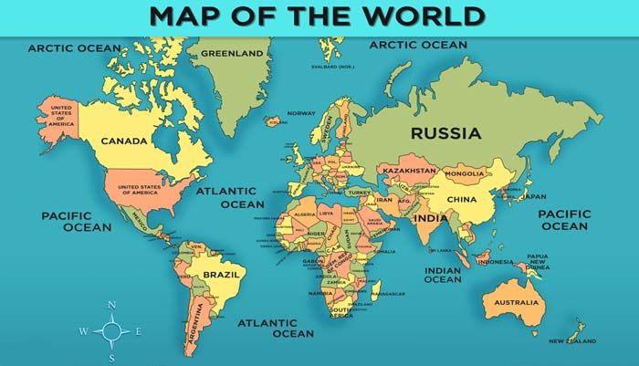

Slide 6
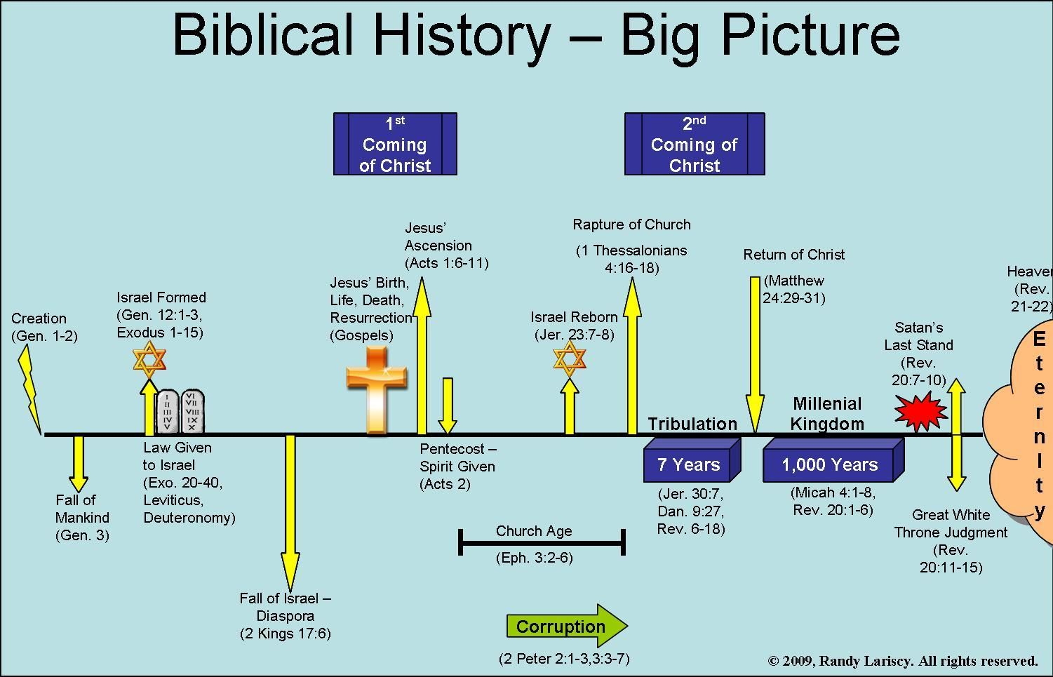

Slide 7
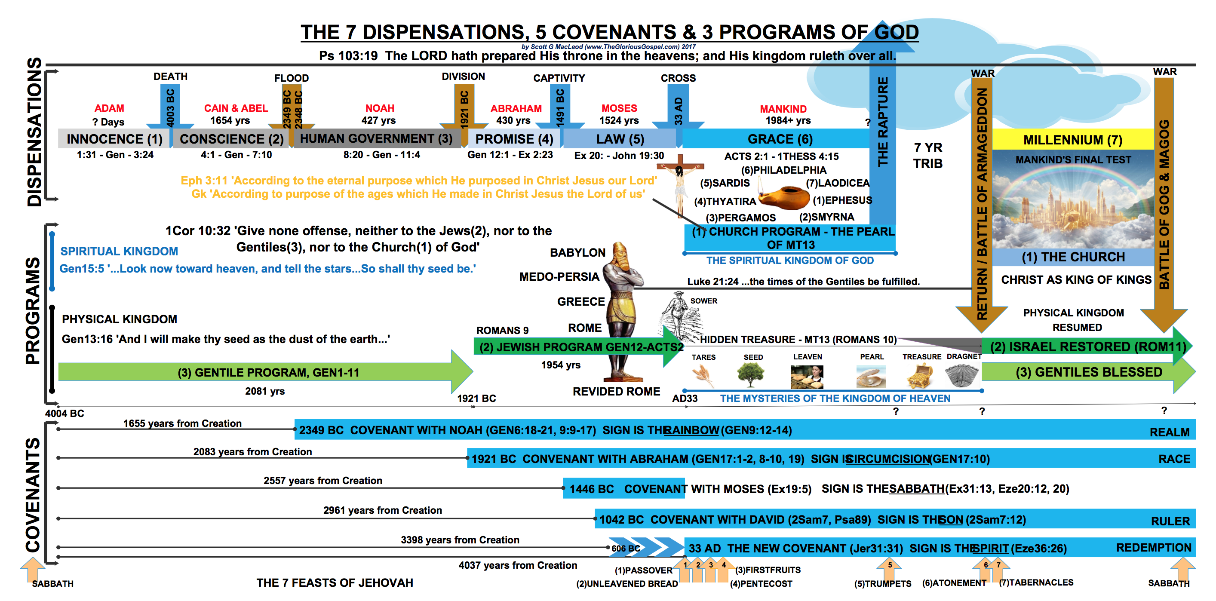

Slide 8
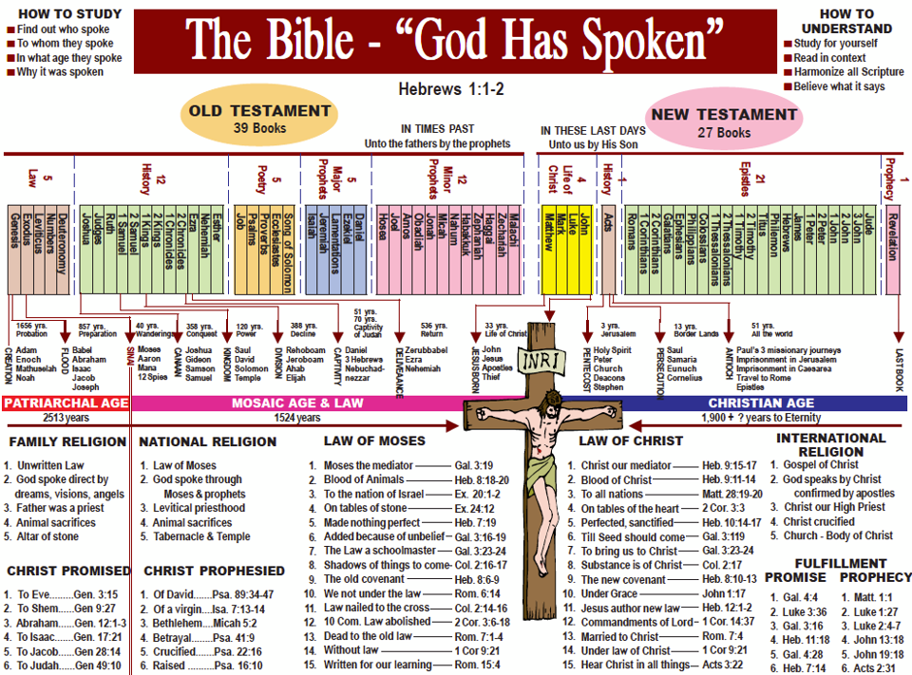

Slide 9
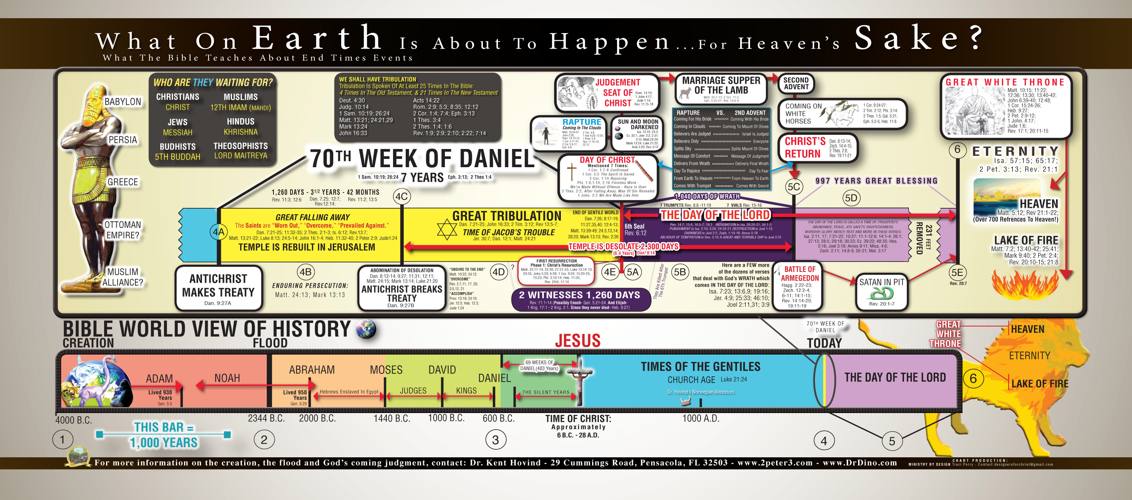

Slide 10
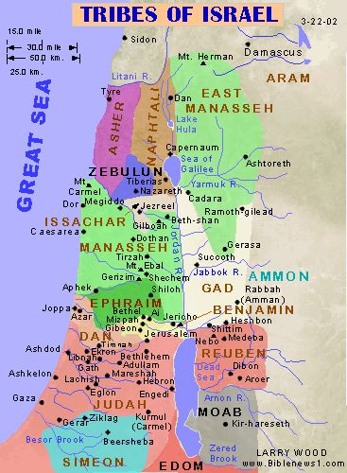

Slide 11
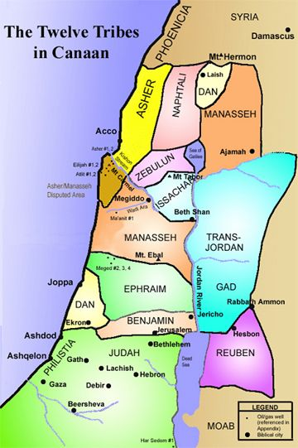

Slide 12
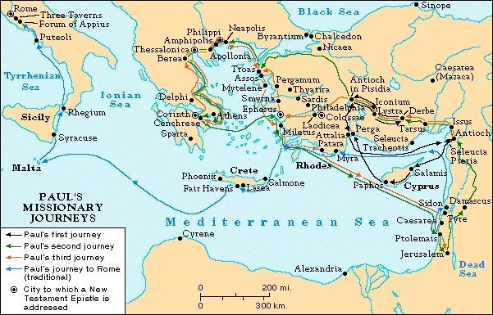

Slide 13
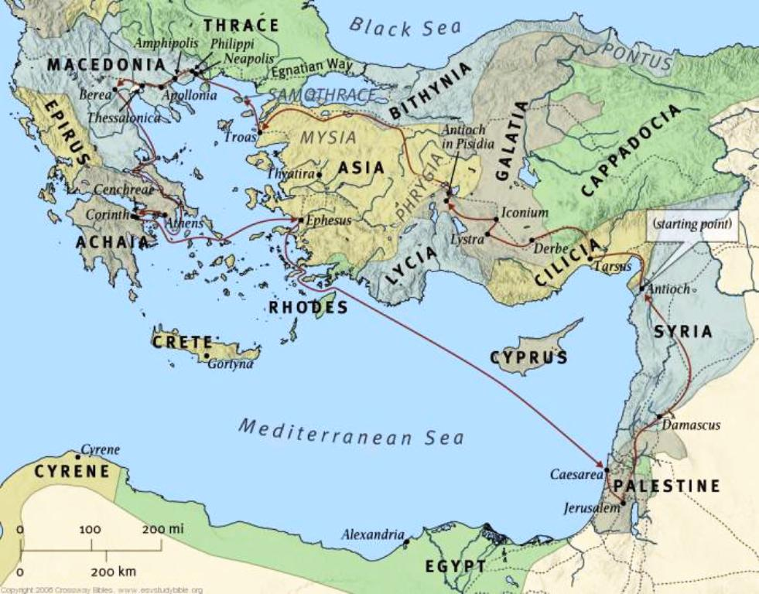

Slide 14
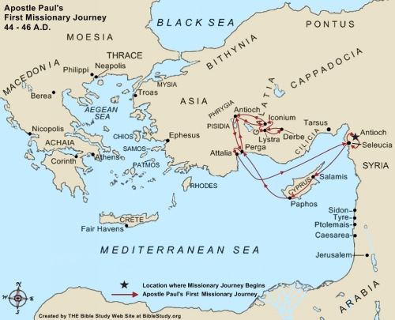

Slide 16
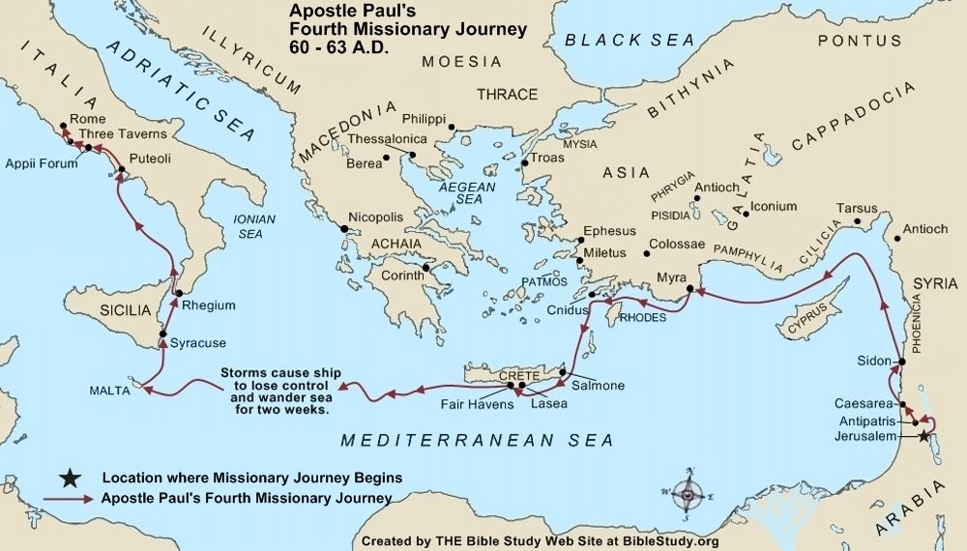

Slide 17
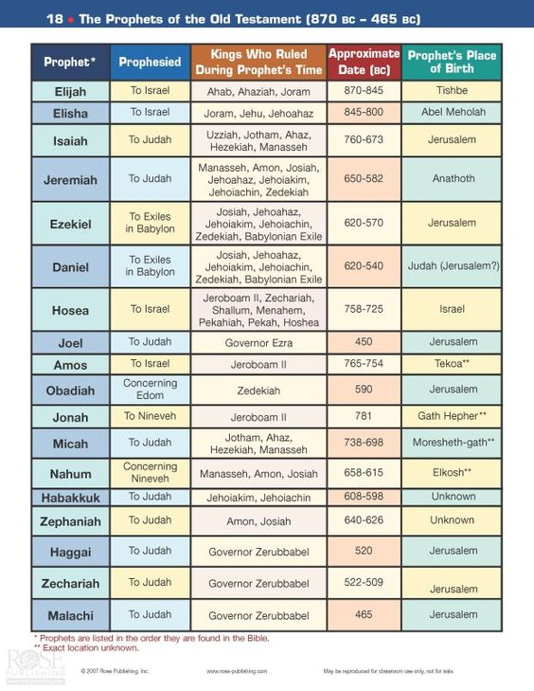

Slide 18
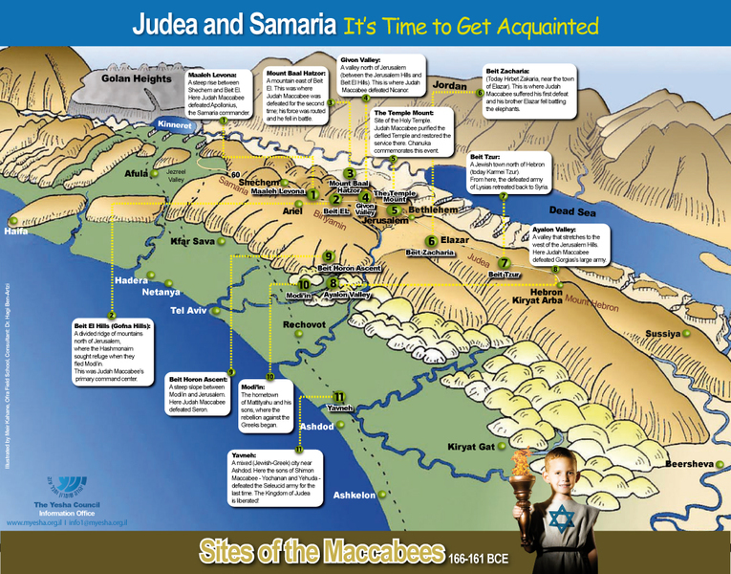

Slide 19
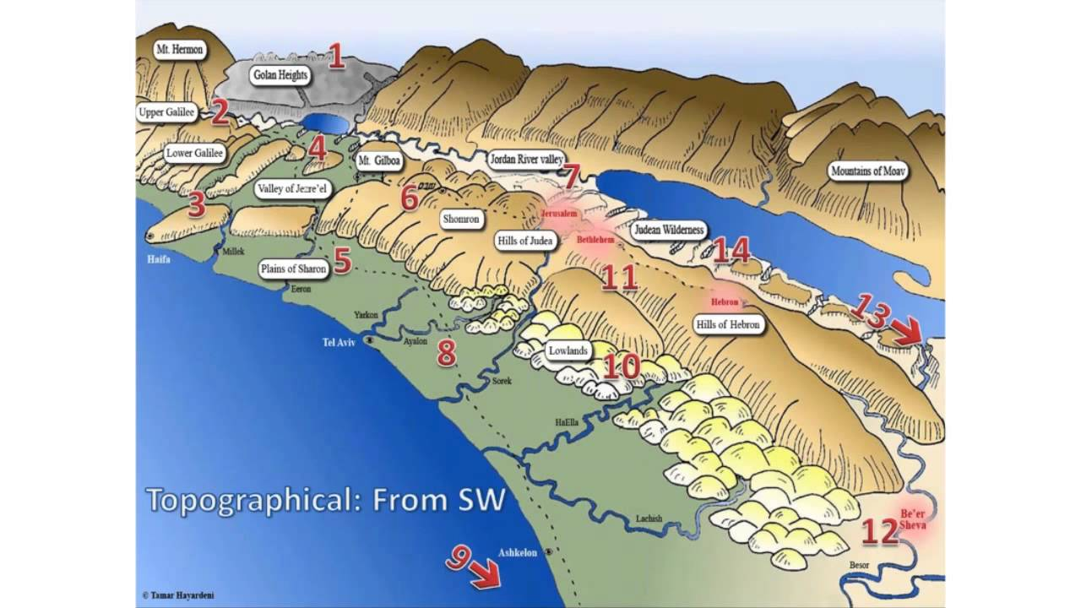

Slide 20
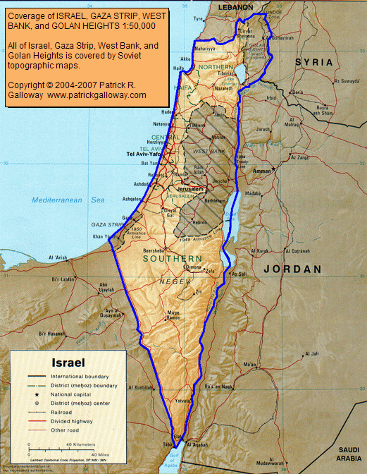

Slide 21
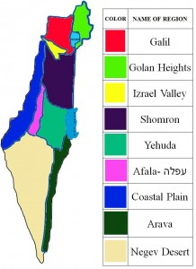

Slide 22
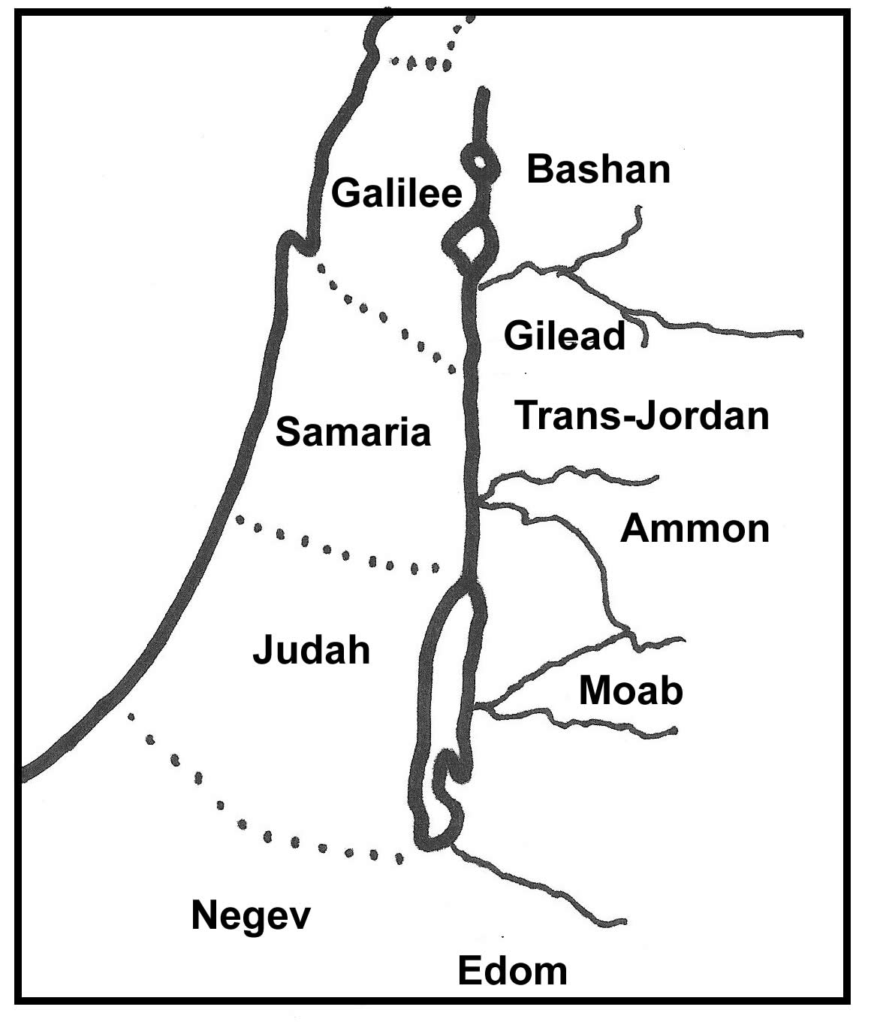

Slide 23
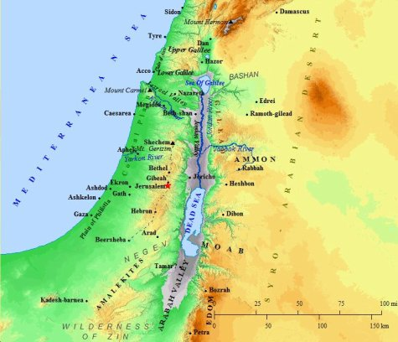

Slide 24
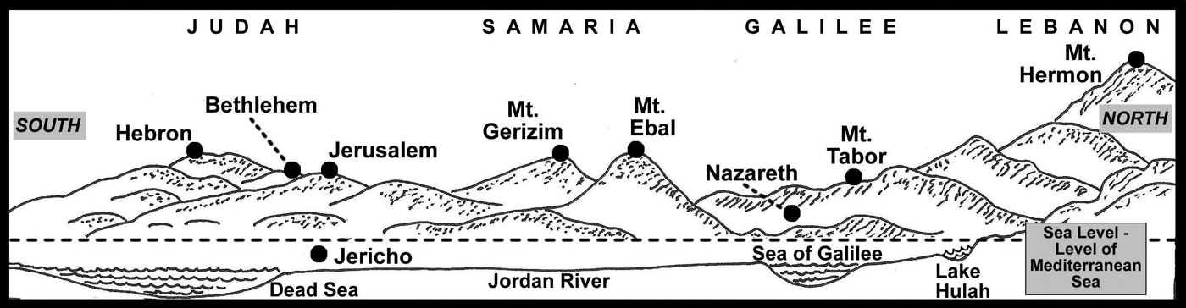

Slide 25
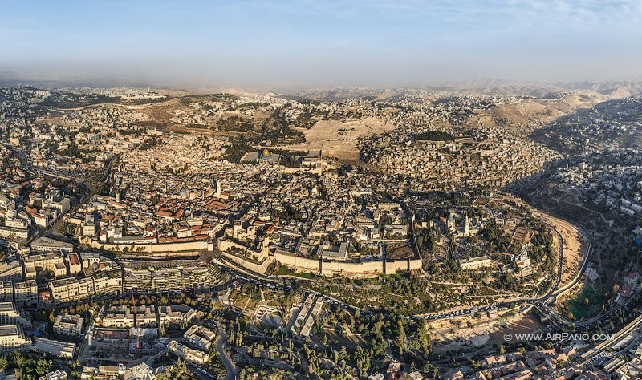
Psalm 125: 1-2 जो लोग यहोवा पर भरोसा रखते हैं, वे माउंट ज़ियोन की तरह हैं, जो हिलाया नहीं जा सकता है लेकिन हमेशा के लिए समाप्त हो जाता है। यरूशलेम के चारों ओर पहाड़, इसलिए प्रभु ने अपने लोगों को घेर लिया दोनों अब और हमेशा के लिए।

Slide 26
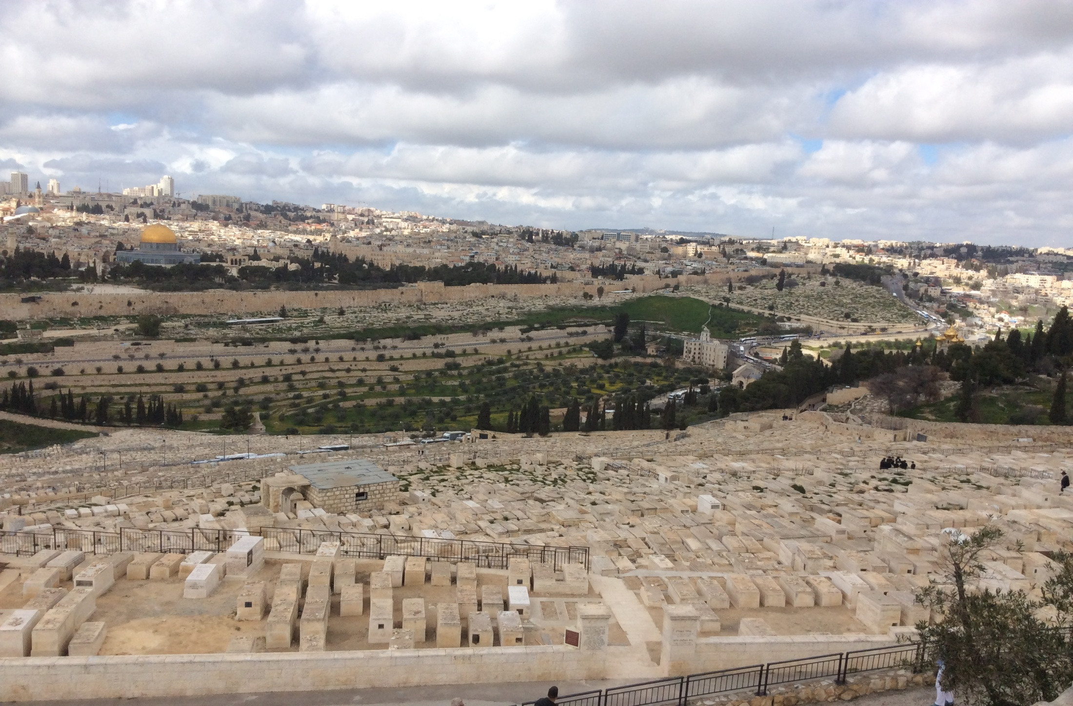
Mount Scopus

Slide 27
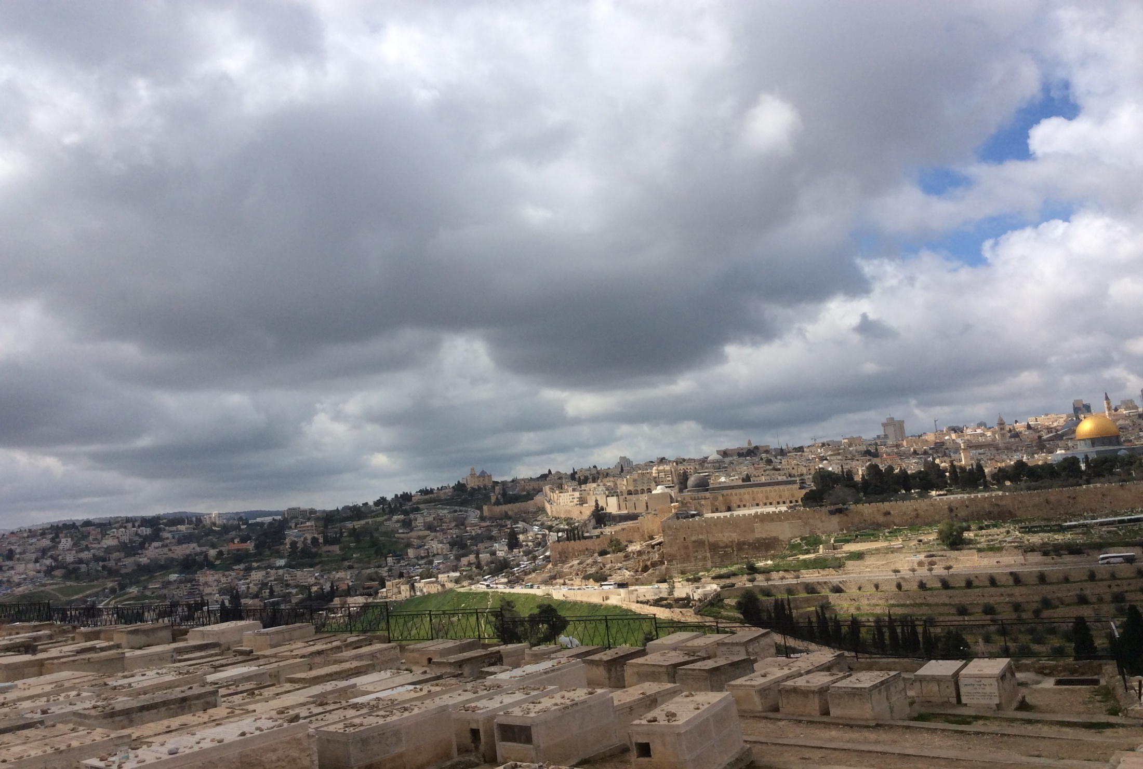
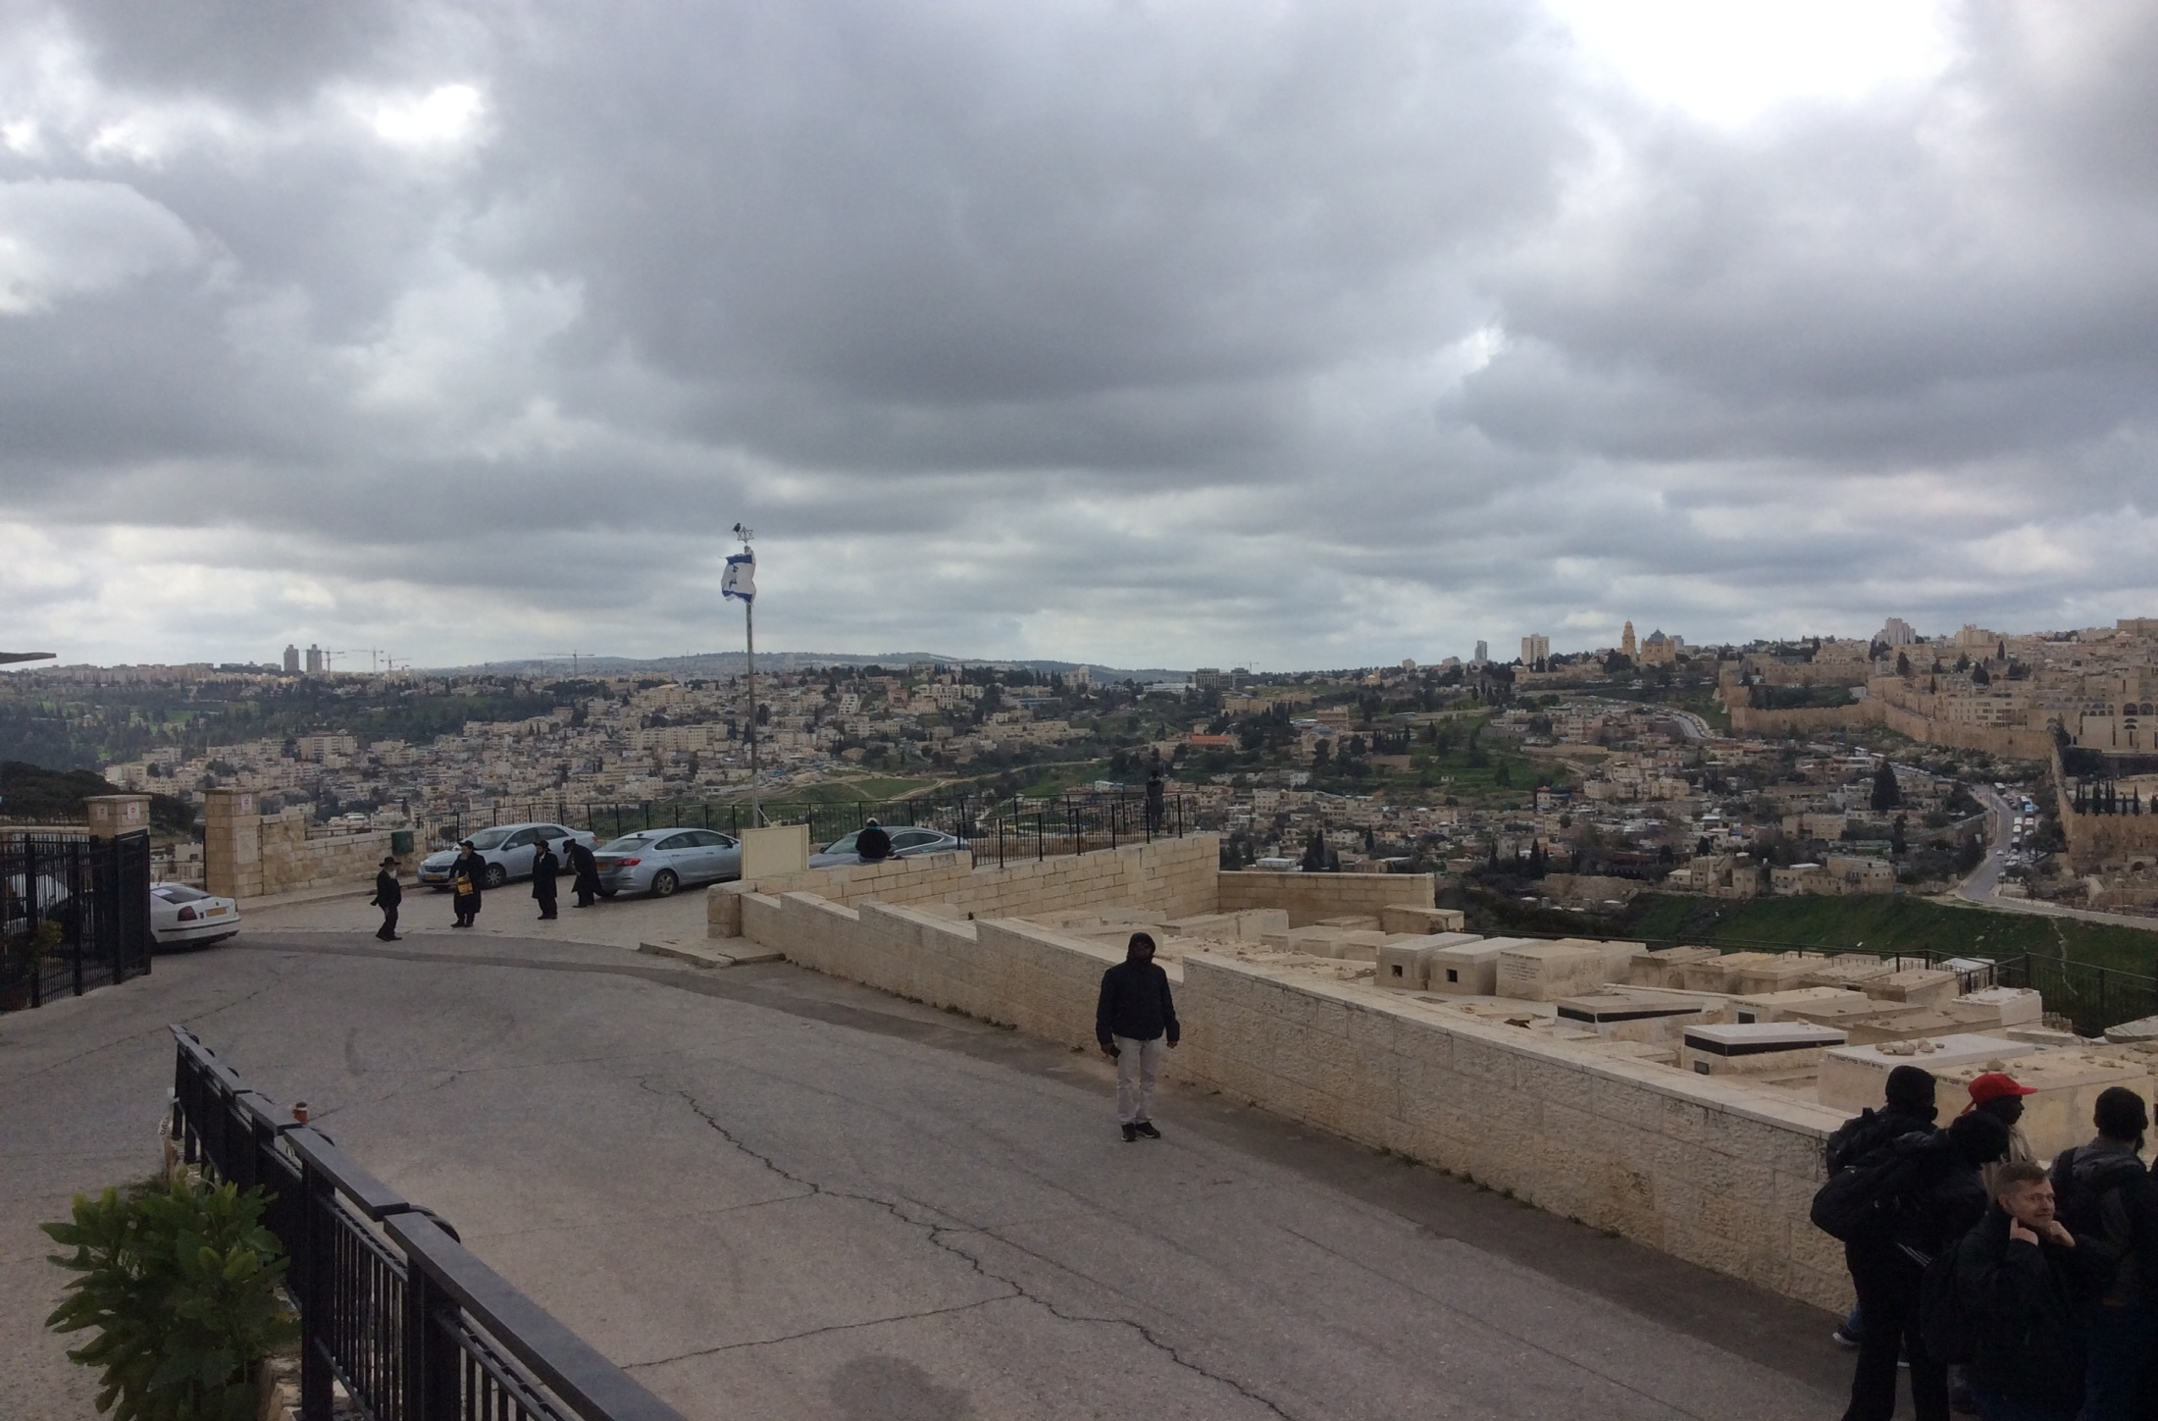
Mount Zion

Slide 28
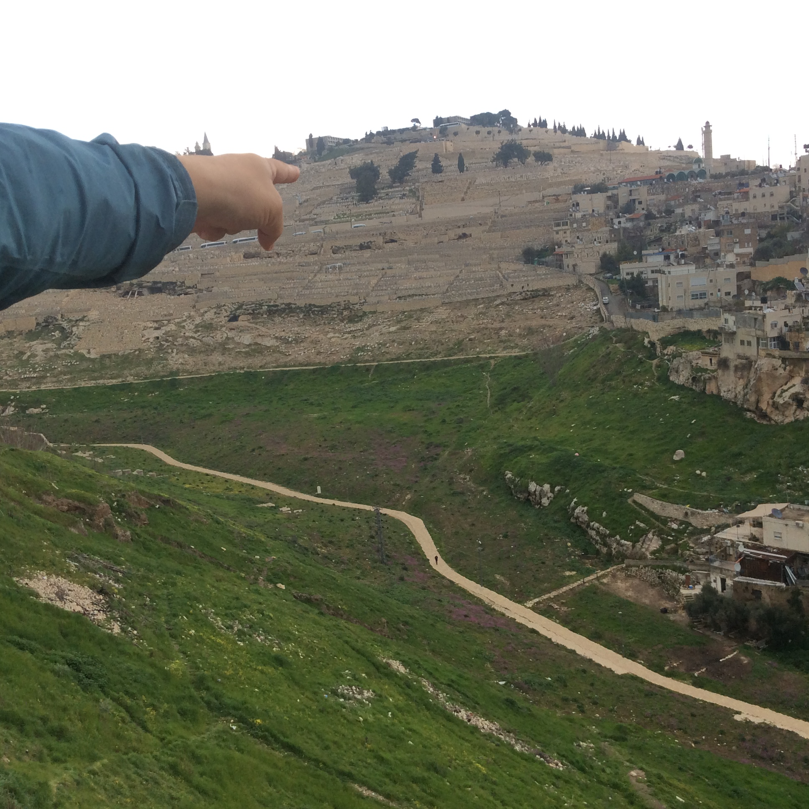
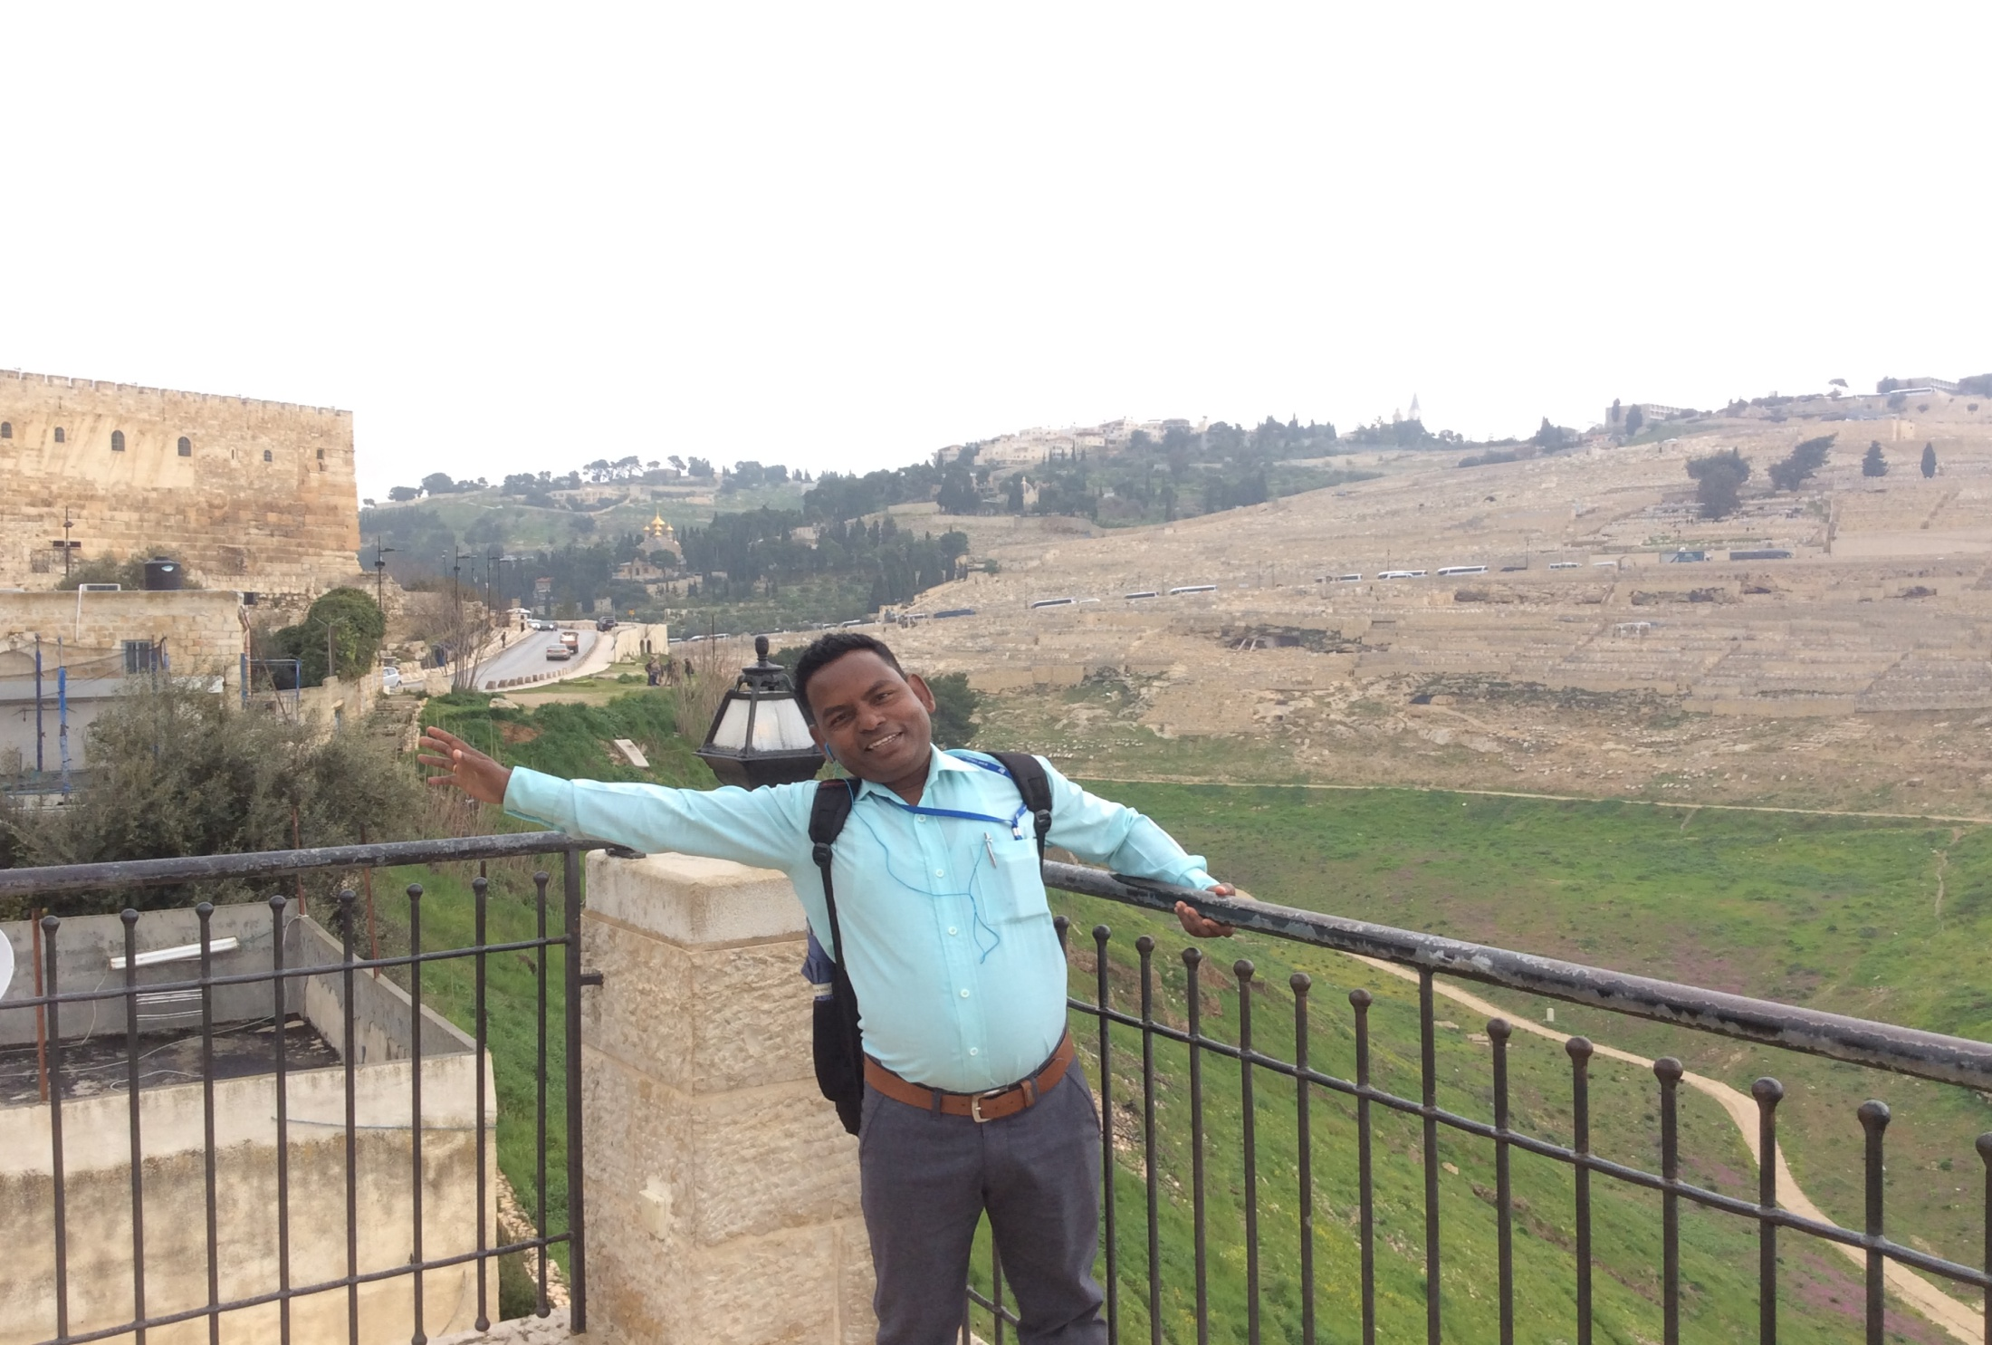
Kidron Valley or valley of Jehoshaphat

Slide 29
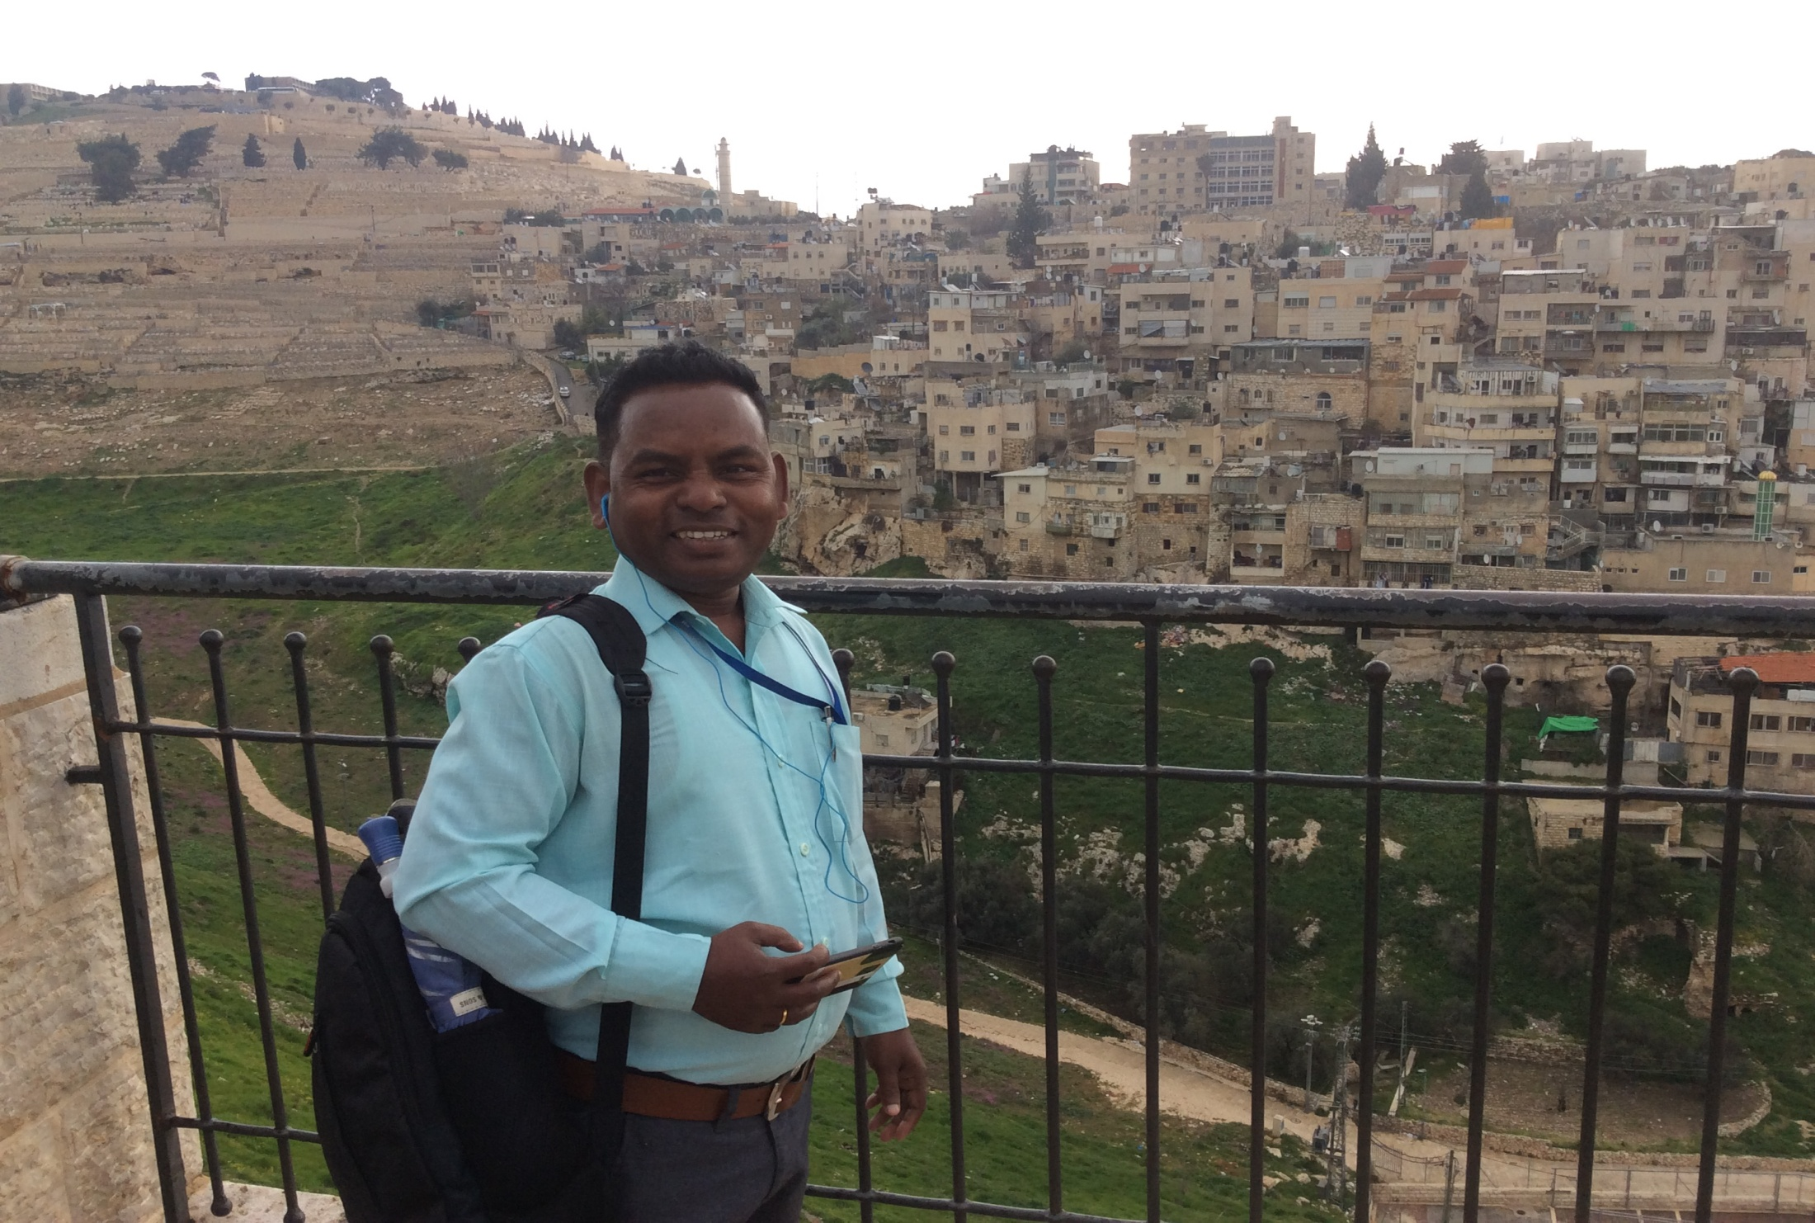
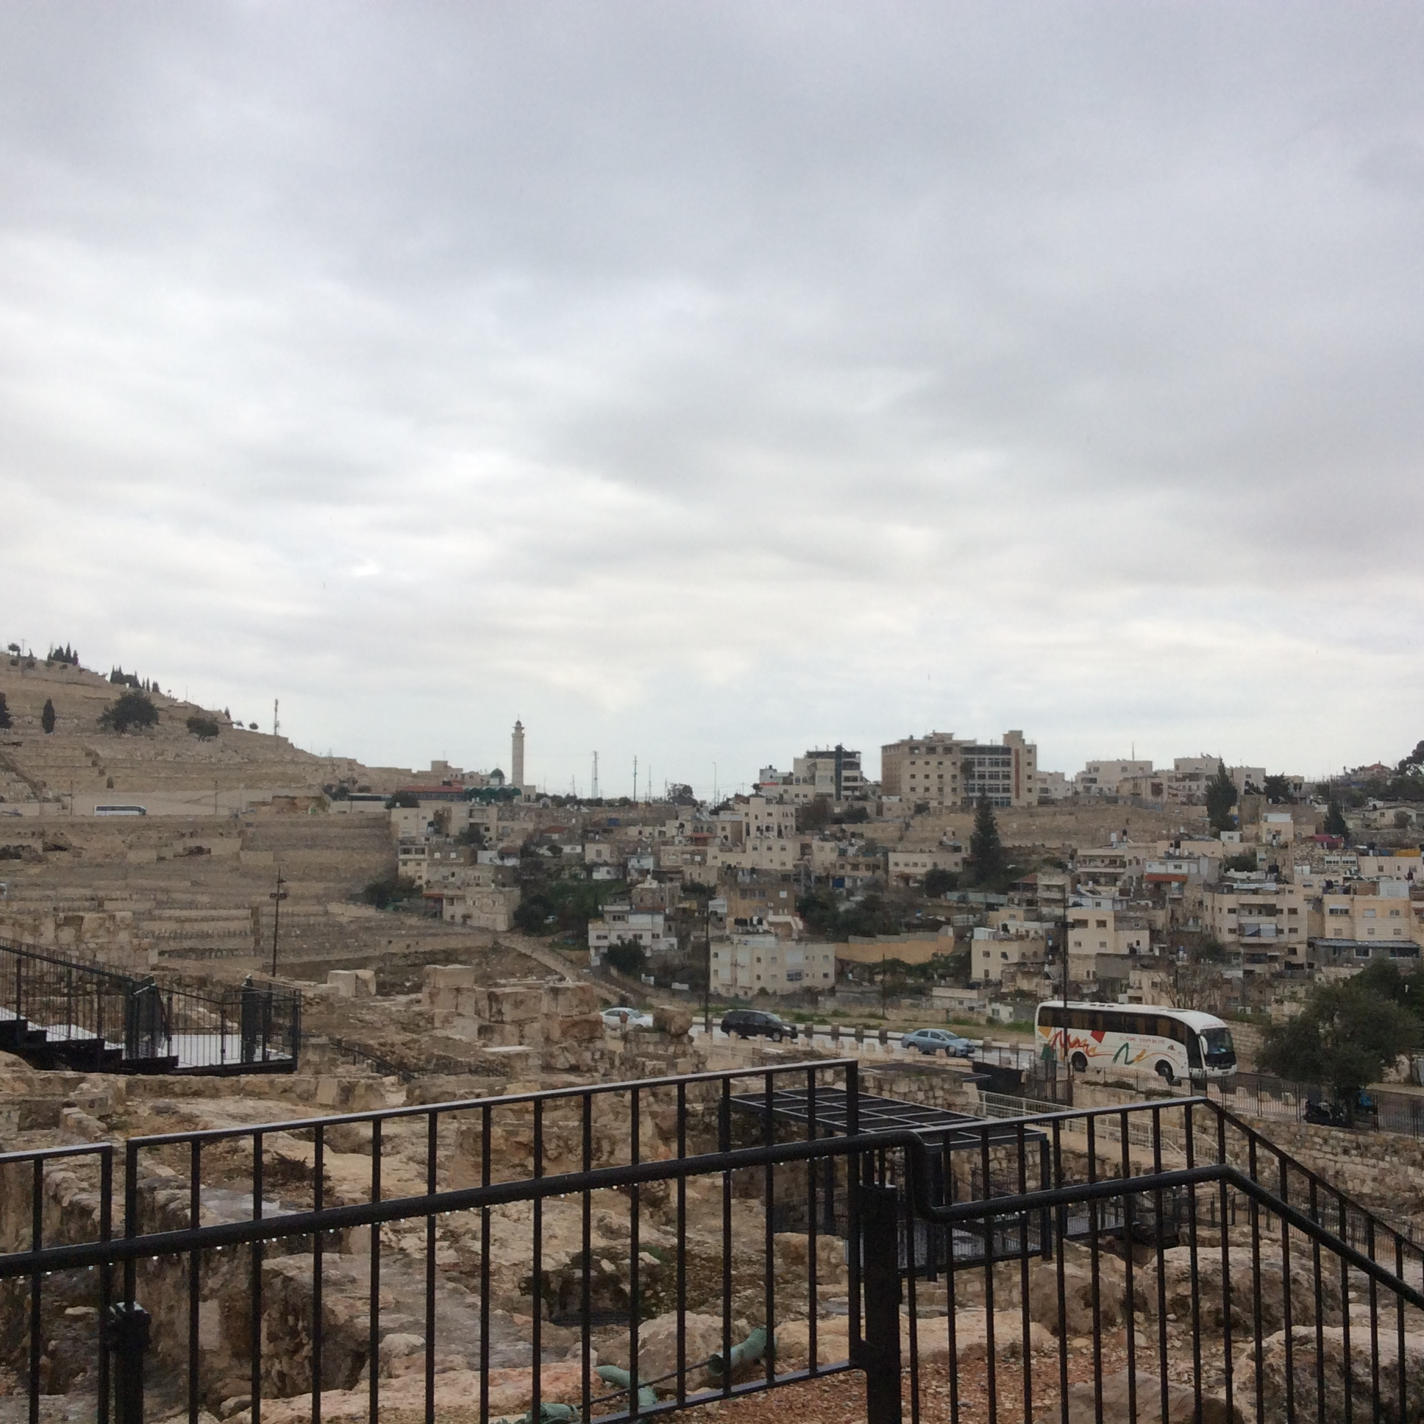
Luke 19: 29 Bethphage and Bethany

Slide 30
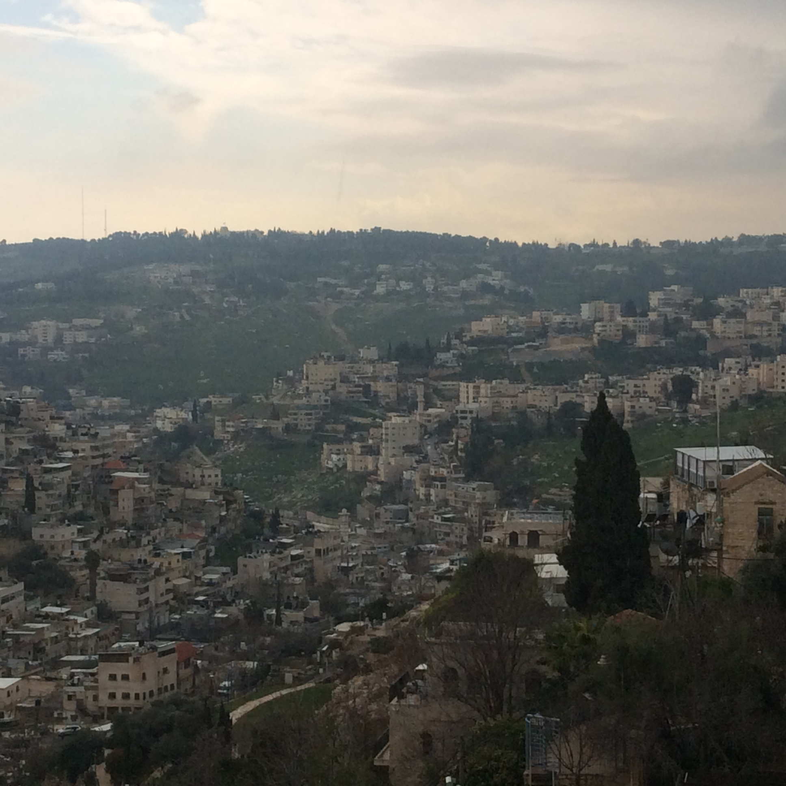
Gehenna (7:31; 19:2-6) Mark 9:47
Hinnom valley

Slide 31
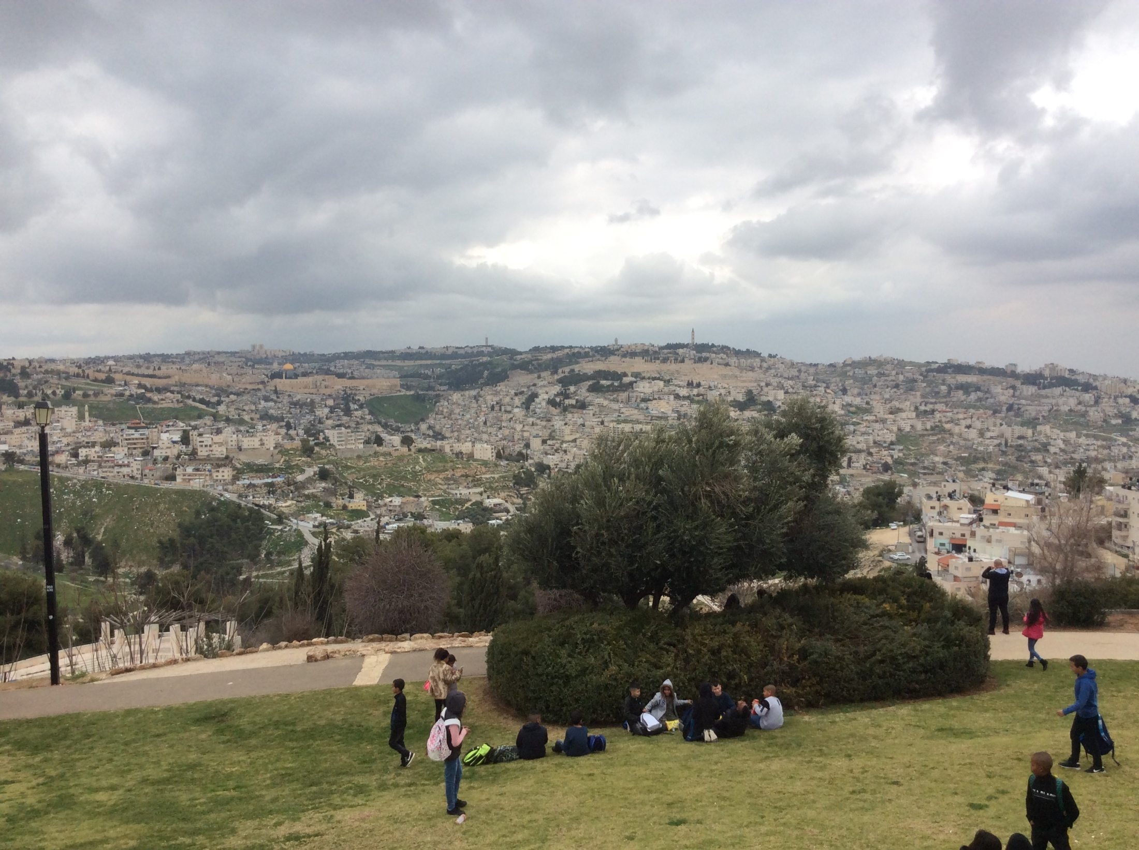
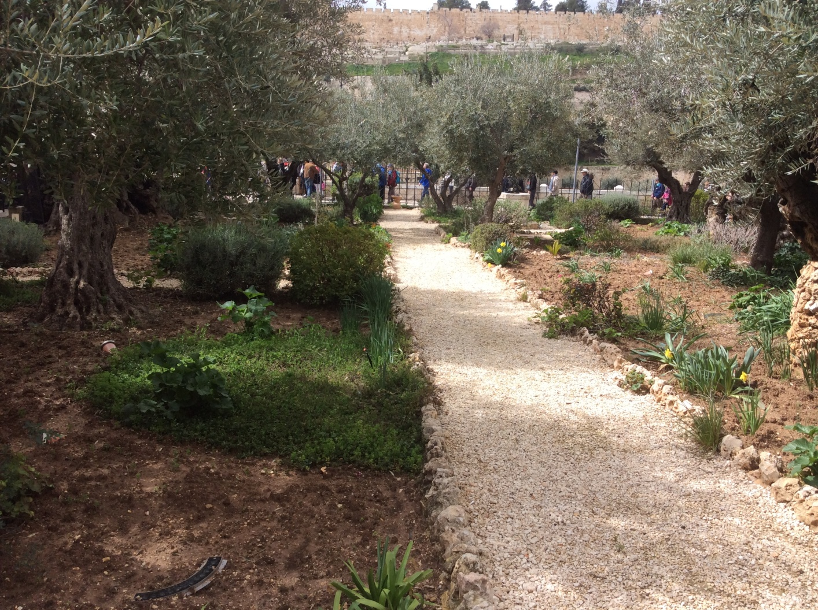
Abraham was tested (Genesis 22)

Slide 32
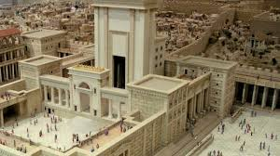
Solomon’s temple

Slide 33
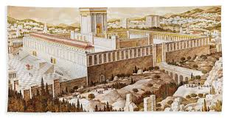
SECOND TEMPLE

Slide 34
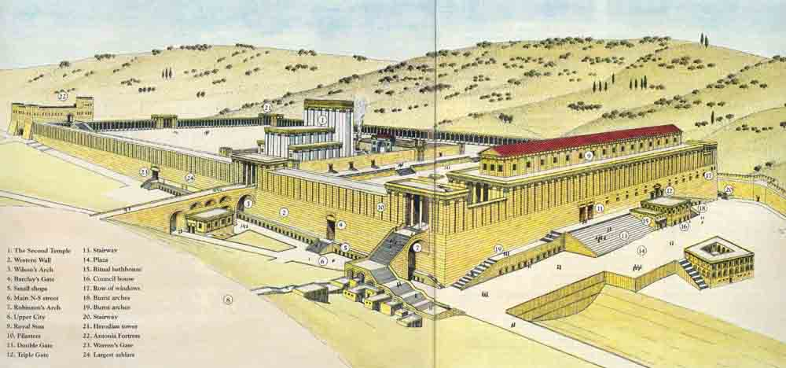
THE TEMPLE IN THE TIME OF HEROD

Slide 35
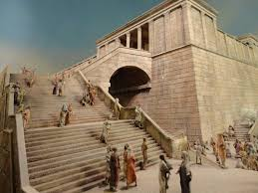

Slide 36
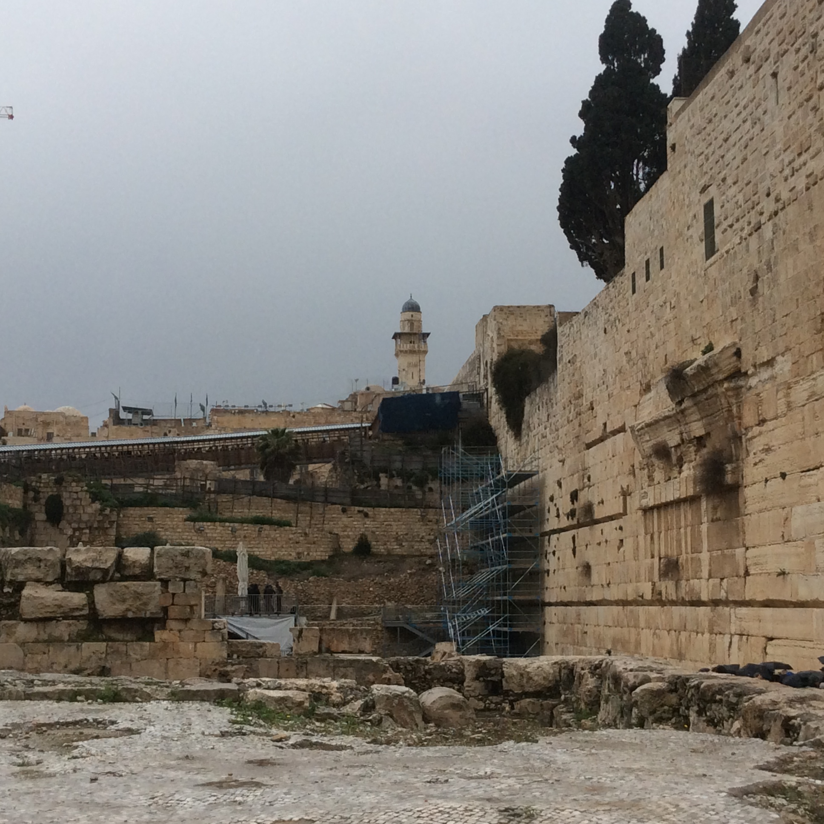

Slide 37
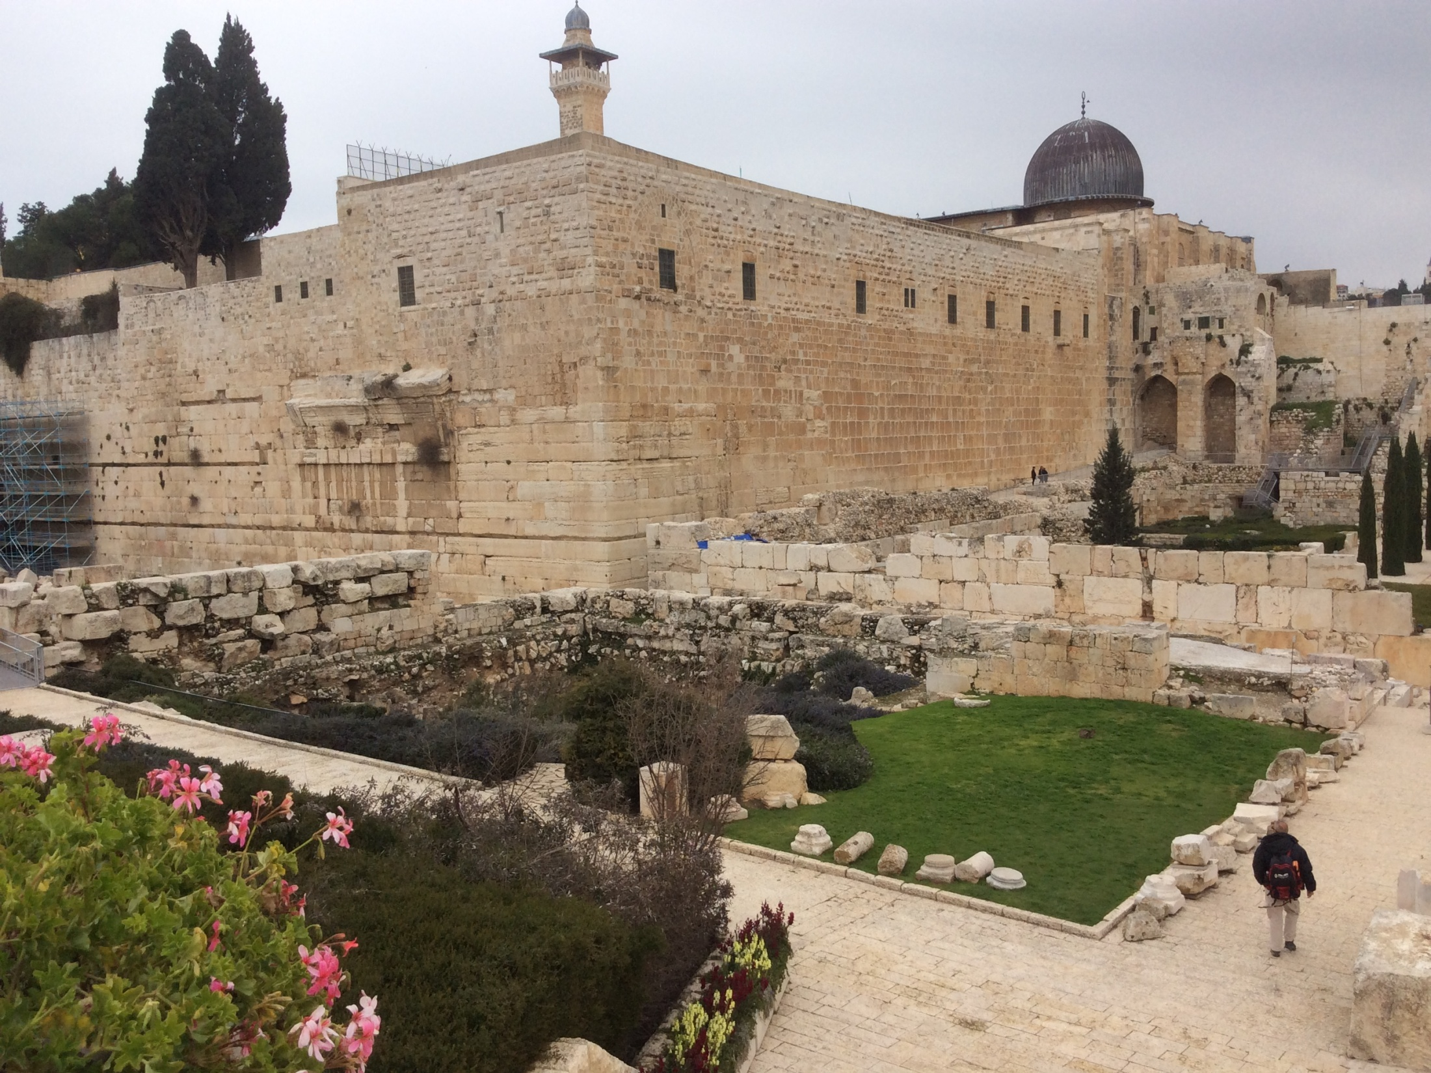

Slide 38
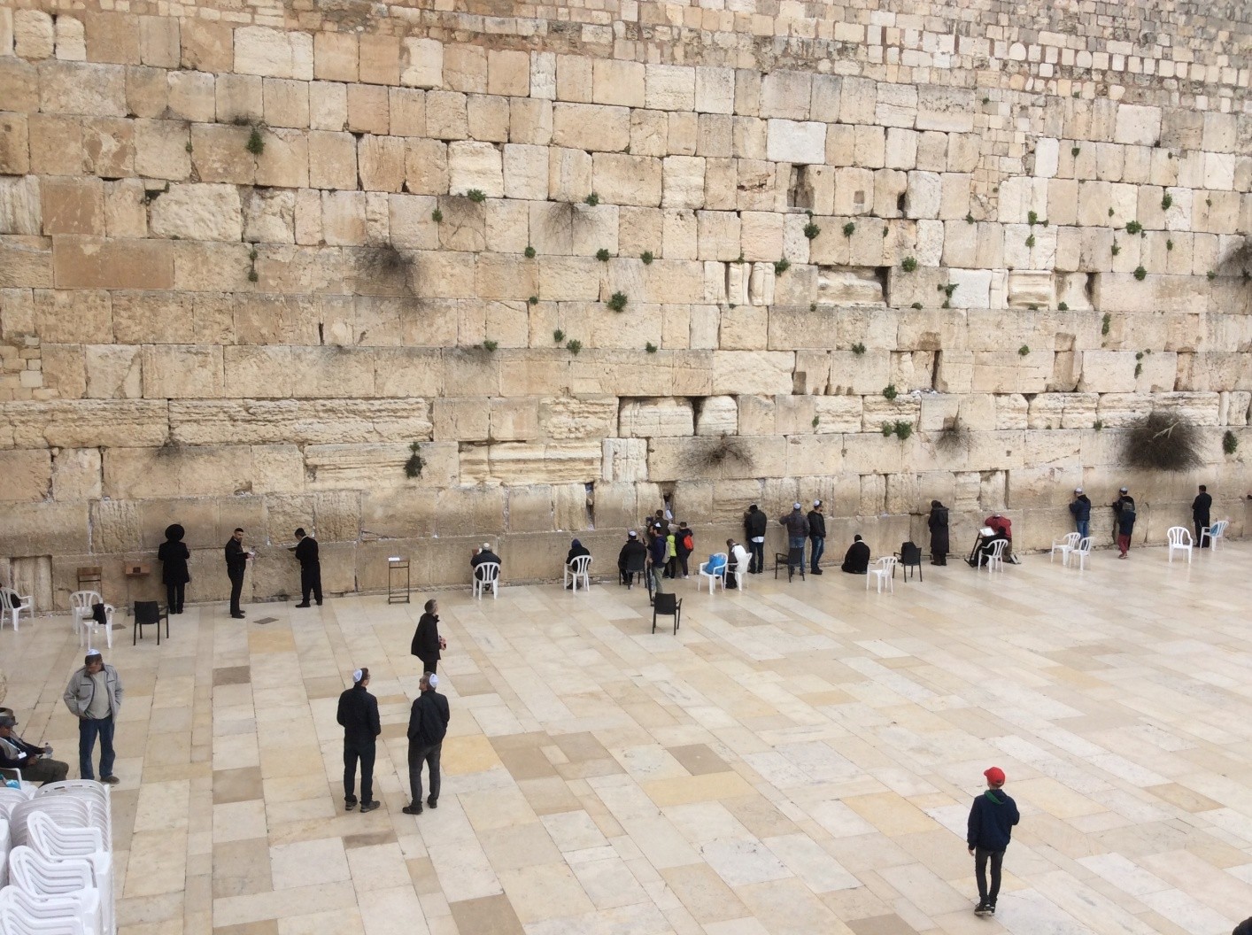
LUKE 19:41-44

Slide 39
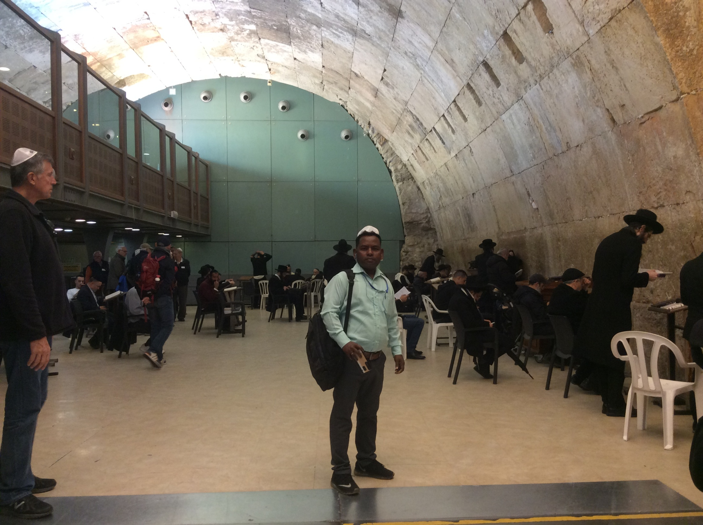

Slide 40
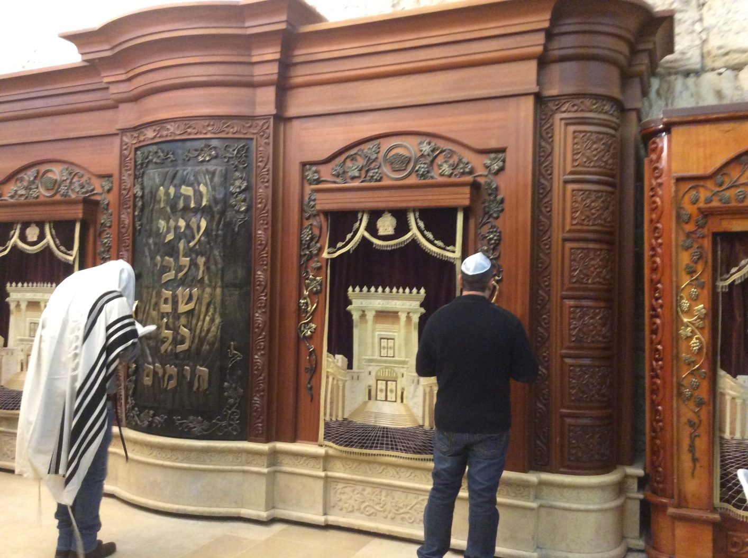

Slide 41
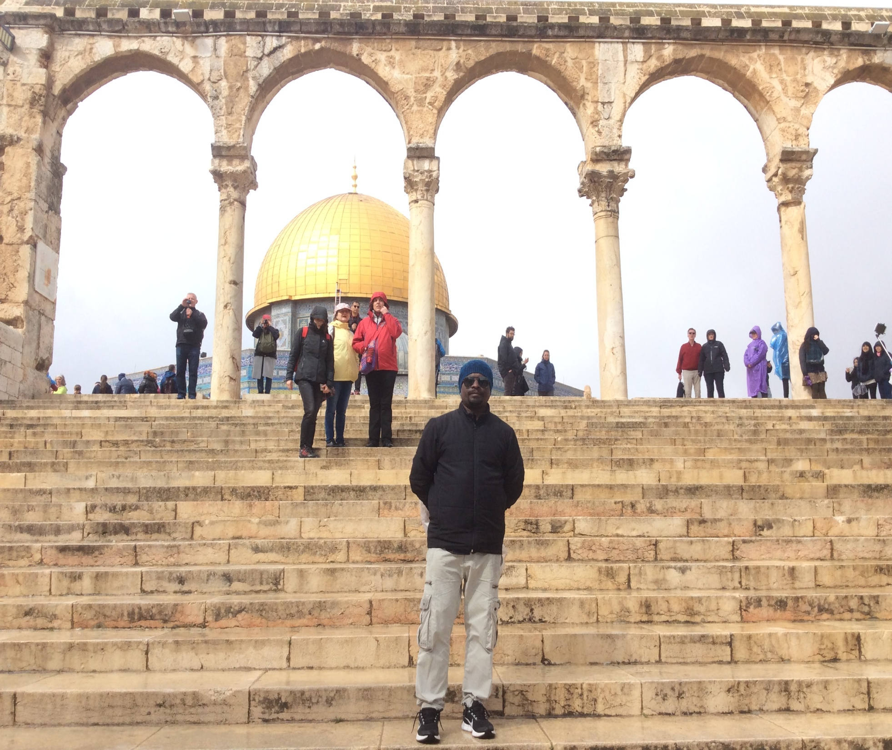
Jerusalem temple at present

Slide 42
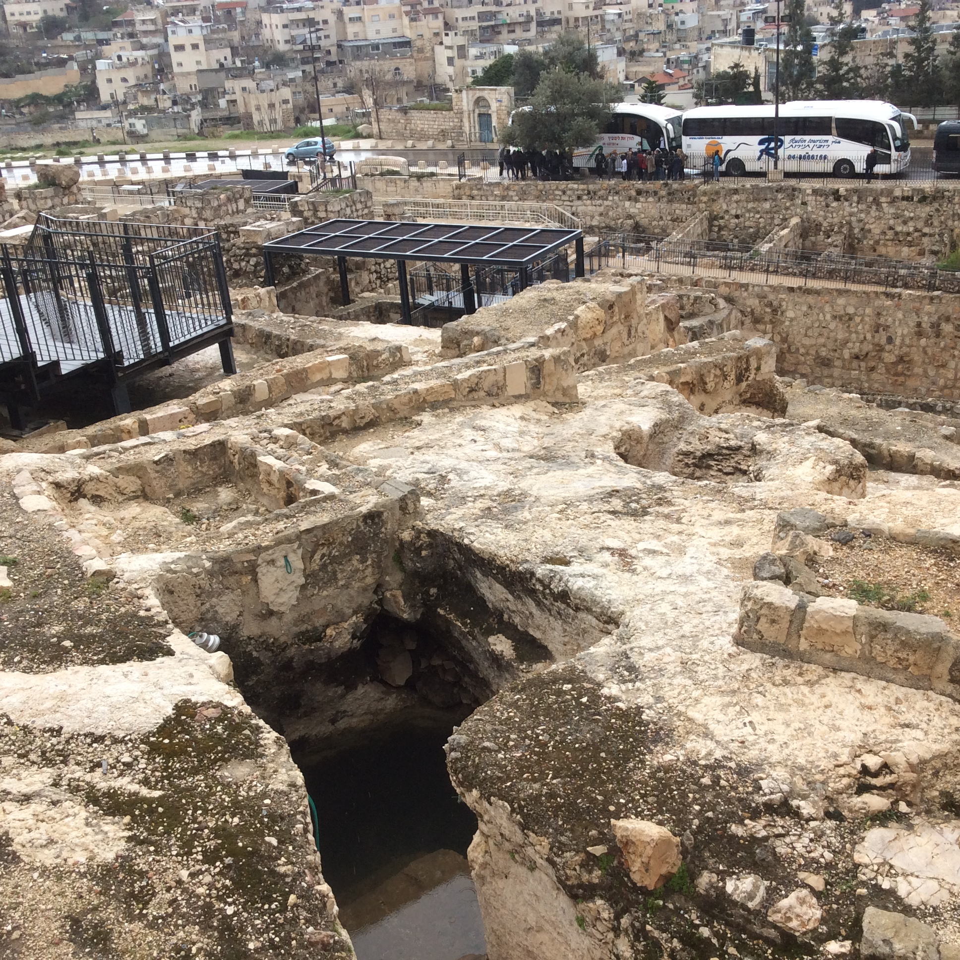

Slide 43
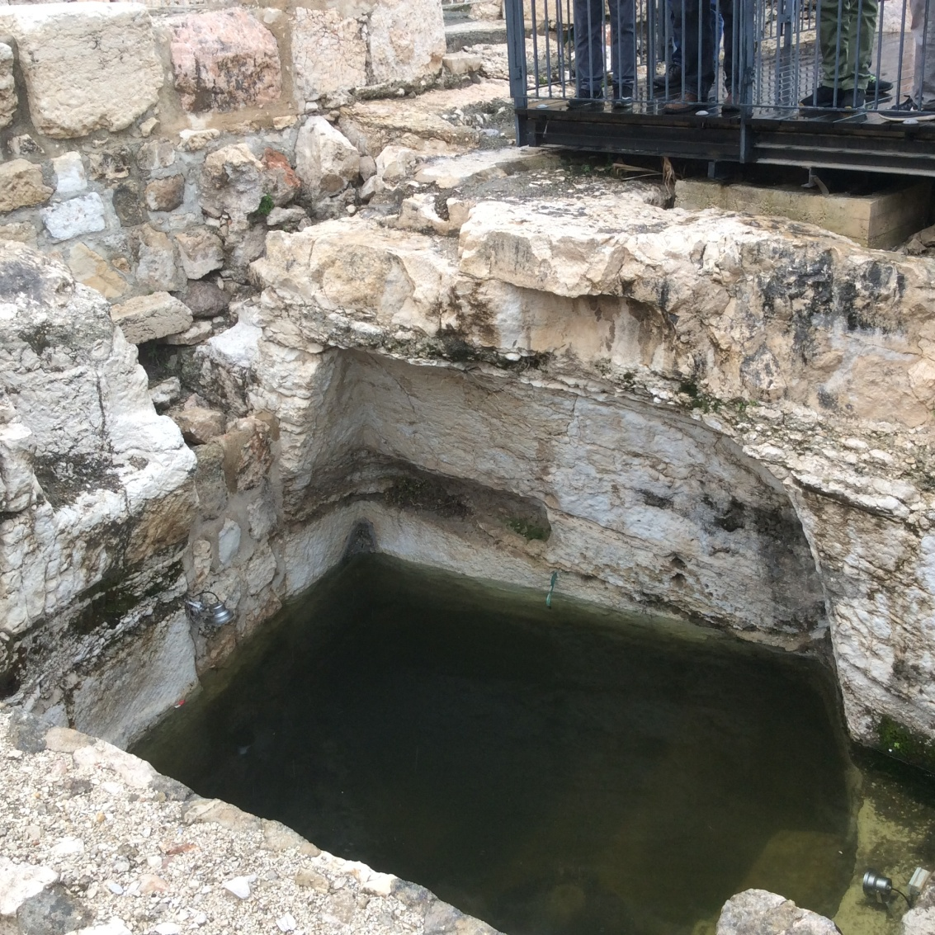

Slide 44
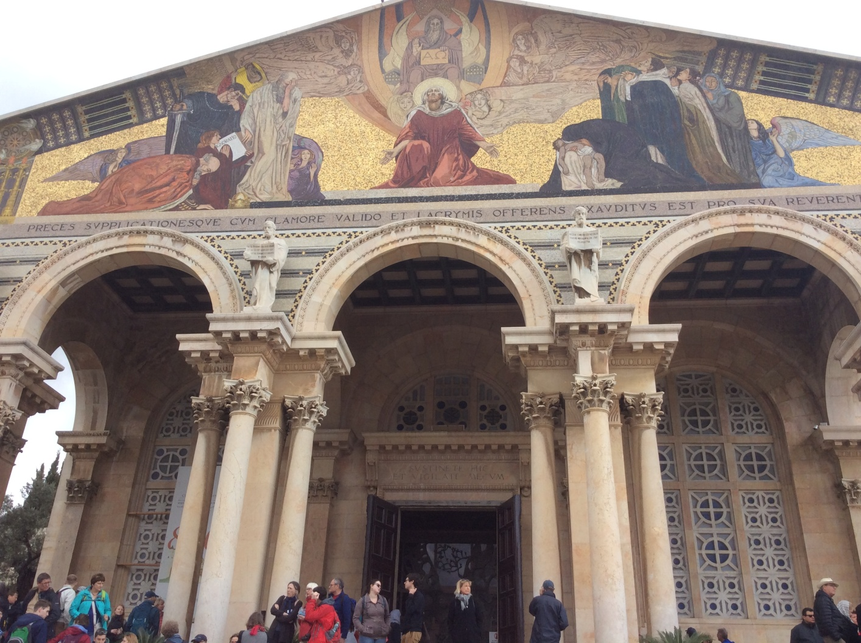
GARDEN OF GETHSEMANE-THE CHURCH OF AGONY

Slide 45
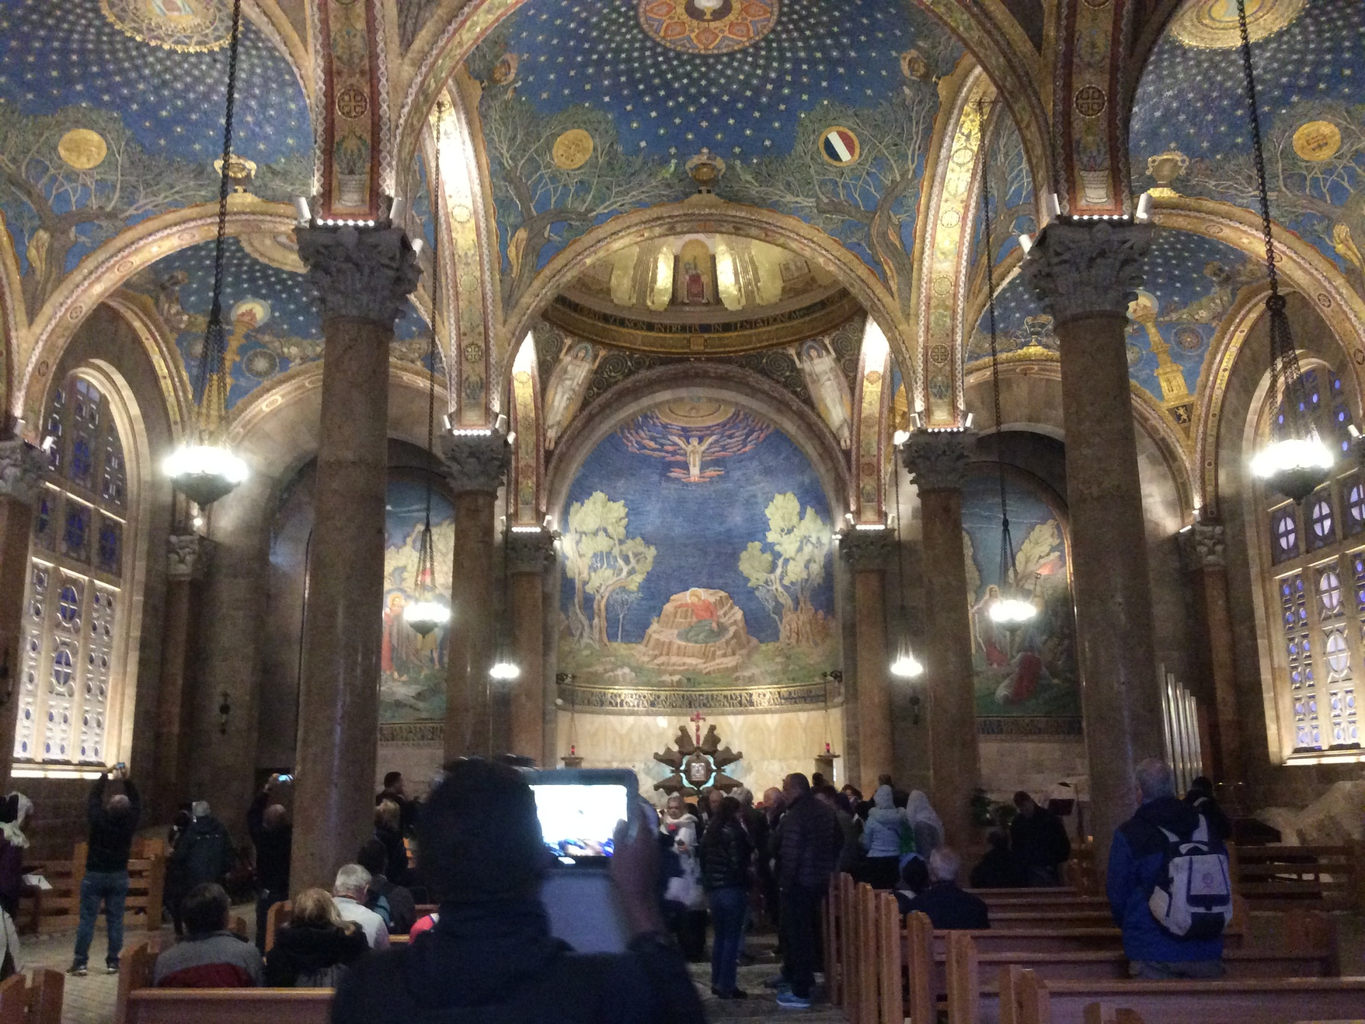

Slide 46
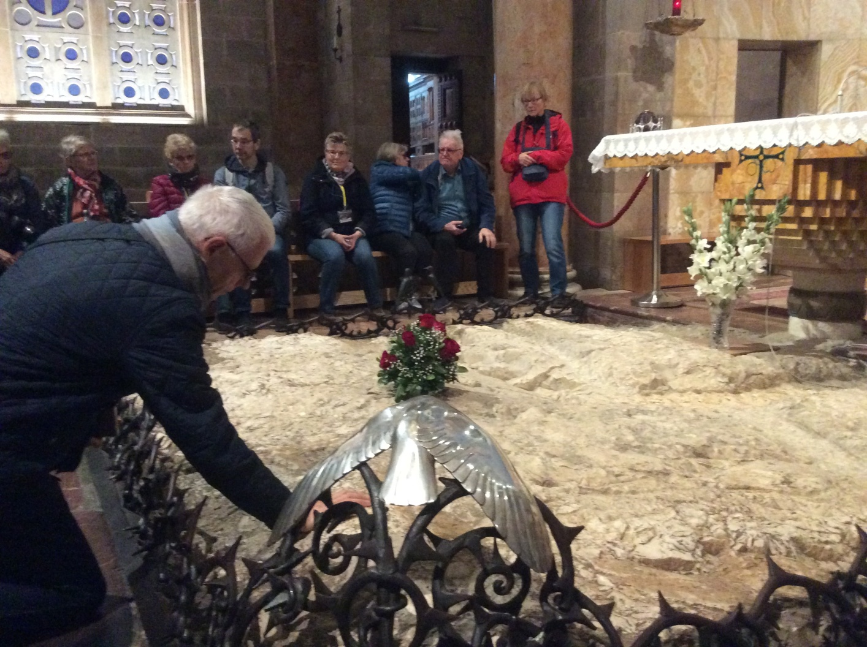
GETHSEMANE

Slide 47
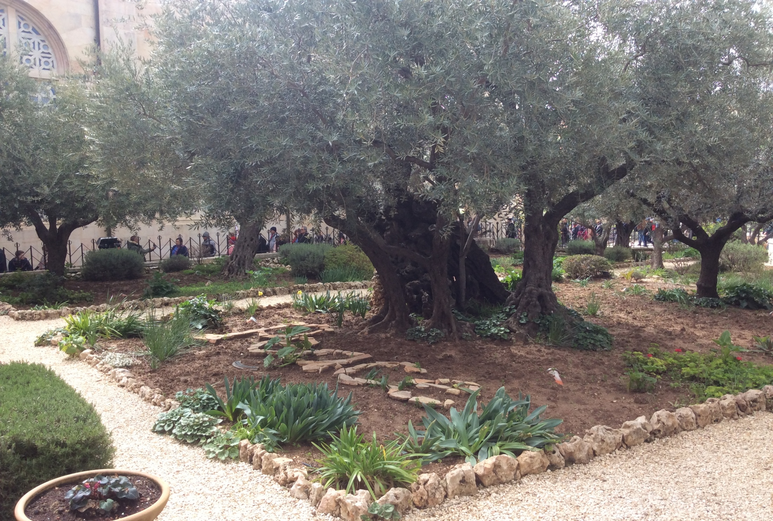
OLIVE TREE

Slide 48
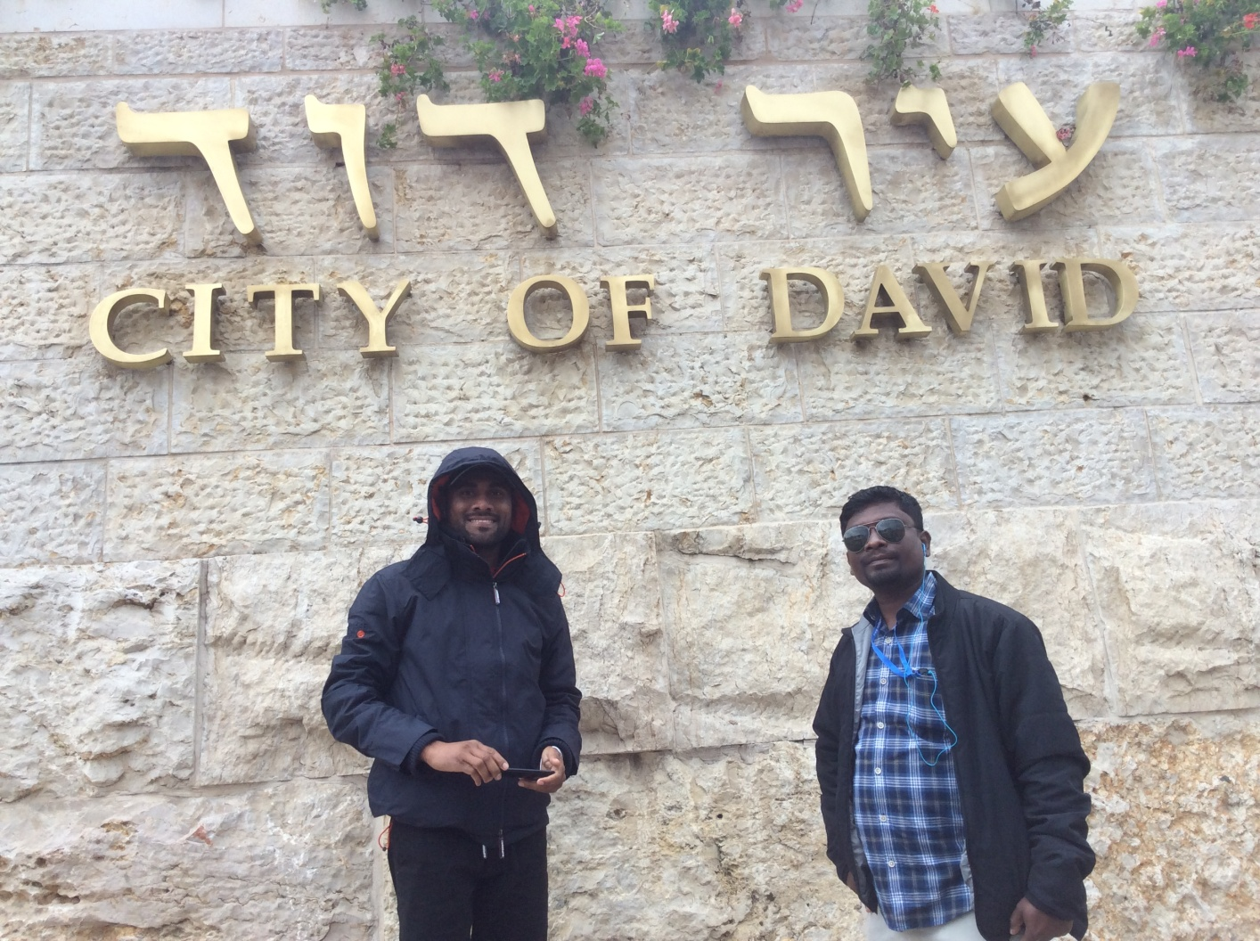

Slide 49

SHILOAH POOL

Slide 50

LACHISH (2 King 18:13-17; Jeremiah 34:6,7)

Slide 51


Slide 52

Southern Kingdom ruled at Lachish

Slide 53

Entrance of the Beersheba

Slide 54

City of Abraham (Beersheba)

Slide 55

PHILISTINE MOTHER god

Slide 56

MYRRH, FRAGRANT CINNAMON WERE KEPT

Slide 57

PHILISTINE FOOD

Slide 58

WORLD HERITAGE-MASADA

Slide 59

MASADA

Slide 60
Masada

Slide 61
Masada

Slide 62

EN GEDI

Slide 63

Qumran

Slide 64


Slide 65

Dead sea

Slide 66


Slide 67

Jordan River

Slide 68

Baptism Site

Slide 69

JERICHO

Slide 70

Deut.34:1-8;

Slide 71


Slide 72

MAGADALA and Genneseret

Slide 73

CAPHARNAHUM

Slide 74

SYNAGOGUE AT CAPHARNAHUM

Slide 75

SEA OF GALILEE

Slide 76



Slide 77


Slide 78

DISCOVERED A BOAT

Slide 79


BEUATITUDE (CHURCH OF APOSTLE)

Slide 80

HAZOR

Slide 81

JOSHUA BURNT THIS CITY

Slide 82

Water Well

Slide 83

JEWS CHILDREN

Slide 84


Slide 85

Abraham’s Gate

Slide 86
Mount दान के उत्खननकर्ताओं ने मेगालिथिक बेसाल्ट ब्लॉक्स या ऑर्थोस्टैट्स के शीर्ष पर मिट्टी की ईंटों से बने एक शहर के गेट का खुलासा किया, जिसका अनुमान लगभग 1750 ईसा पूर्व बनाया गया था। इसका लोकप्रिय नाम अब्राहम गेट है, बाइबिल की कहानी के कारण जो अब्राहम ने अपने भतीजे लूत (उत्पत्ति 14:14 :) को बचाने के लिए दान की यात्रा की।

Slide 87

THE ENTRANCE GATE T0 DAN FROM THE TIME OF ISRAELITE’S KINGDOM

Slide 88
according to 2 Kings 10:29 and 2 Chronicles 13:8, Jeroboam erected two golden calves as gods in Bethel and Dan. Textual scholars believe that this is where the Elohist story of Aaron’s Golden calf actually originates, due to opposition in some sections of Israelite society (including the Elohist themselves) to the seeming idol-worship of Jeroboam. However, some Biblical scholars believe that Jeroboam was actually trying to outdo the sanctuary at Jerusalem (Solomon's Temple), by creating a seat for God that spanned the whole kingdom of Israel, rather than just the small space above the Ark of the Covenant in Jerusalem; the seat for God in the Jerusalem sanctuary was represented by a cherubim on either side, and so Jeroboam might have been using the calves to represent the sides of his seat for God – implying his whole kingdom was equal in holiness to the Ark.

Slide 89

Joshua 19: 47-48; Judges 18

Slide 90


Slide 91
DAN STREAM

Slide 92

Caesarea Philippi (Matt. 16:13-28

Slide 93


Slide 94

MOUNT OF HARMON

Slide 95

BASAN (GOLAN)

Slide 96


Slide 97


Slide 98

Tomb at Nazareth

Slide 99


Slide 100
LIVING STYLE IN NAZERETH

Slide 101

PRESSING STONE (OLIVE OIL)

Slide 102


Slide 103


Slide 104


Slide 105


Slide 106


Slide 107


Slide 108


Slide 109

Ceasrea

Slide 110


Slide 111

Birth Place of Amos- Takoa

Slide 112


HERODIUM

Slide 113

How does it look at present?

Slide 114

MEKPELA

Slide 115

Hebron- Mekhphela forefathers burial place

Slide 116


Slide 117


Slide 118


